Slide 1
Bulk Topological Superconductor

Slide 2
Possible Topological Superconductors
“Periodic Table” of topological invariant
SC in TI surface
Chiral p-wave
Schnyder-Ryu-Furusaki-Ludwig (2008)
Kitaev (2009)
1D
2D
3D
Time-Reversal Broken (TRB)
Z₂
Z
-
(D)
Time-Reversal Invariant (TRI)
Z₂
Z₂
Z
(DIII)
Surface State of TIs
φ = π
φ = 0
Bogoliubov qp
SC
SC
E_{F}
2Δ
E_{F}
Majorana
Edge State
TI
Fu & Kane (2008)
Sr₂RuO₄

Slide 3
Possible Topological Superconductors
“Periodic Table” of topological invariant
SC in TI surface
Kitaev model
Chiral p-wave
Schnyder-Ryu-Furusaki-Ludwig (2008)
Kitaev (2009)
1D
2D
3D
Time-Reversal Broken (TRB)
Z₂
Z
-
(D)
Time-Reversal Invariant (TRI)
Z₂
Z₂
Z
(DIII)
InSb/
NbTiN
1D Nanowire of InSb or InAs
Mourik et al., Science (2012)
Majorana
End-State
Das et al., Nature Phys. (2012)
InAs/Al
Oreg et al., PRL (2010)
Lutchyn et al., PRL (2010)
Alicea, RPP (2012)

Slide 4
Possible Topological Superconductors
“Periodic Table” of topological invariant
SC in TI surface
Kitaev model
Chiral p-wave
Schnyder-Ryu-Furusaki-Ludwig (2008)
Kitaev (2009)
1D
2D
3D
Time-Reversal Broken (TRB)
Z₂
Z
-
(D)
Time-Reversal Invariant (TRI)
Z₂
Z₂
Z
(DIII)
Superfluid ³He-B phase
New 3D topological state of matter
E
The surface state may host
Helical Majorana Fermions
that are itinerant and massless
E_{F}
k_{y}

Slide 5
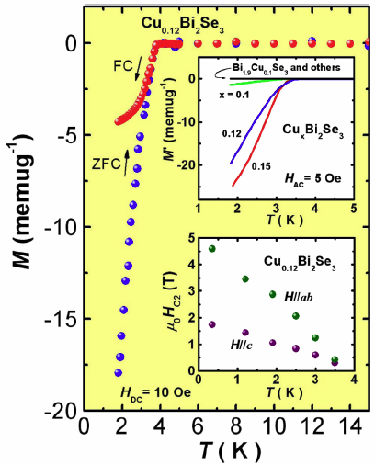
SC in Cu_{x}Bi₂Se₃
Hor et al., PRL (2010)
Four-component Hamiltonian of Bi₂Se₃
with the basis
( | P1_{z}⁺↑⟩, | P1_{z}⁺↓⟩, | P2_{z}⁻↑⟩, | P2_{z}⁻↓⟩ )
E
Topological SC
State in the bulk
Fu & Berg, PRL (2010)
E_{F}
k
→ Helical Majorana fermions
E
Conventional SC State in the bulk
→ Proximity SC
E_{F}
Majorana zero mode in vortices
k
Hosur et al., PRL (2011)

Slide 6
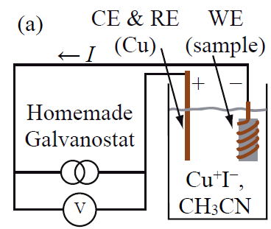
SC in Cu_{x}Bi₂Se₃
Hor et al., PRL (2010)
Problem:
Sample is difficult to prepare, shielding fraction is low.
Zero Resistivity
Specific Heat Jump
E
SC V.F.
≈ 70%
Topological SC
State in the bulk
Fu & Berg, PRL (2010)
E_{F}
k
→ Helical Majorana fermions
E
Conventional SC State in the bulk
→ Proximity SC
E_{F}
Majorana zero mode in vortices
k
Hosur et al., PRL (2011)

Slide 7
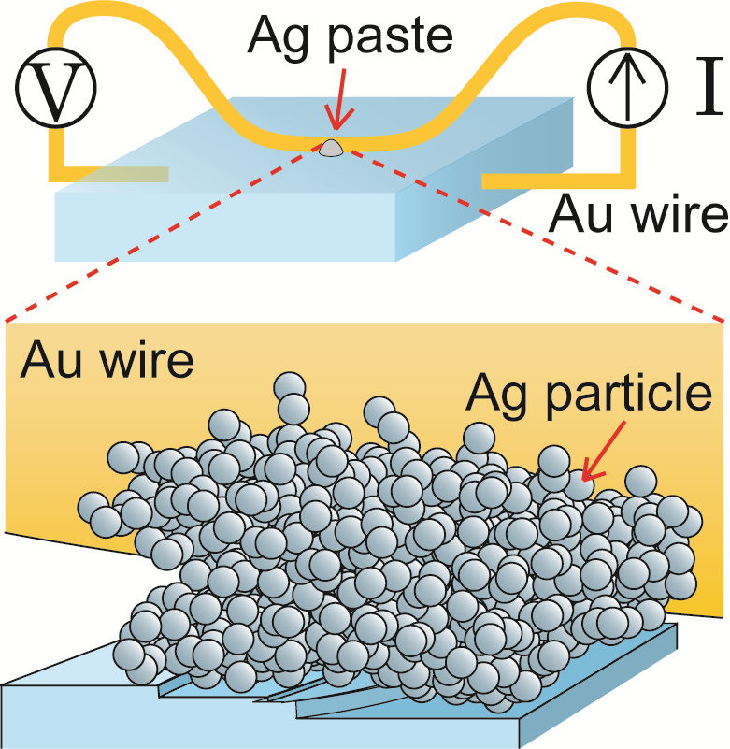
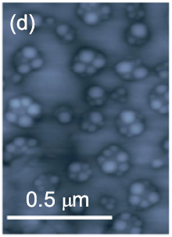
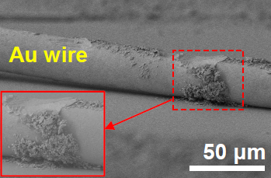
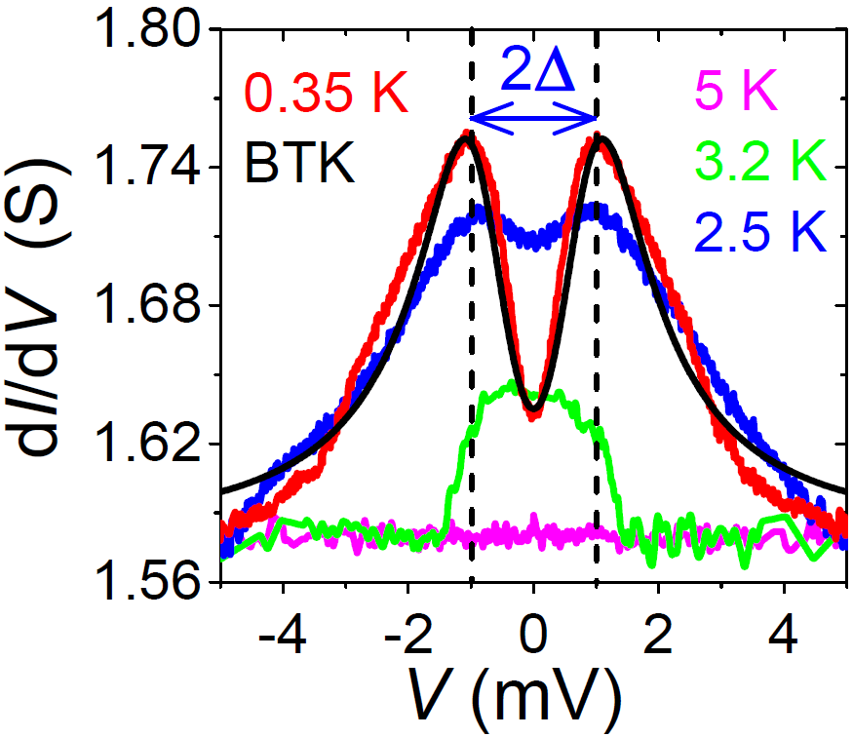
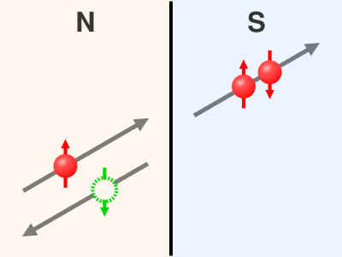
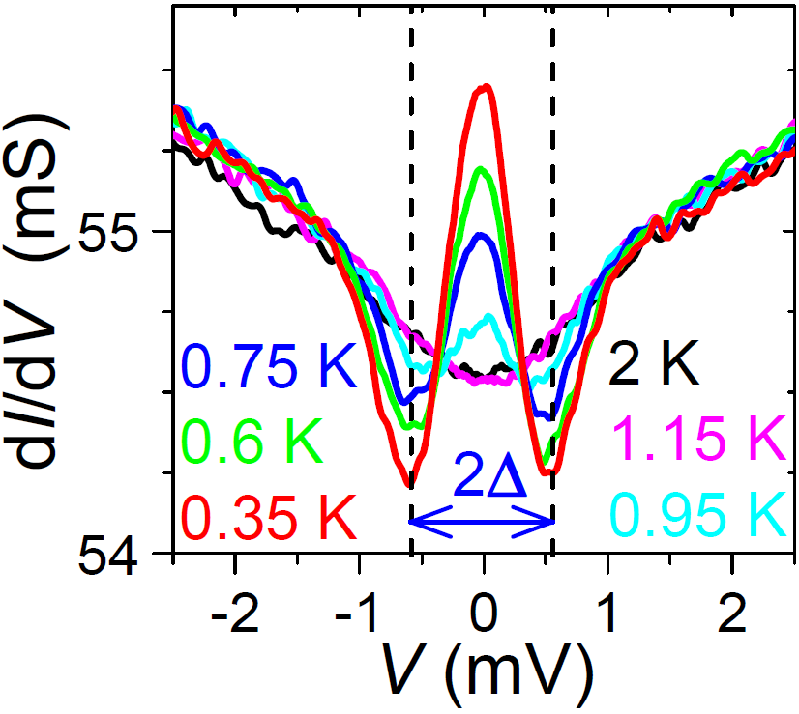
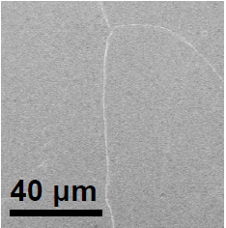
“Soft” Point Contact
Sasaki, Ando et al., PRL (2011)
Ag particles on the surface
SEM image of an actual sample
B-dep.
(Ag particle size ~50 nm)
Sn
Cu_{x}Bi₂Se₃
T-dep.
Notes:
7

Slide 8
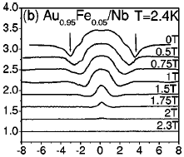
Effects of Heating and/or Critical Currents?
Example of a spurious ZBCP
T = 0.35 K
Sheet et al., PRB (2004)
H-dep.
Andreev bound state due to an unconventional SC state
G(V)/G_{n}
V (mV)
Dip position moves with H
Peak height is insensitive to H
H dependence is completely
different!
1 T
0.75 T
0.5 T
0 T
0
Reflectionless tunneling would
be governed by L_{φ} ~ 1 μm and
suppressed with ~1 mT.
Notes:
8

Slide 9

Possible SC States in Cu_{x}Bi₂Se₃
Four-component Hamiltonian of Bi₂Se₃ ( | P1_{z}⁺↑⟩, | P1_{z}⁺↓⟩, | P2_{z}⁻↑⟩, | P2_{z}⁻↓⟩ )
Sasaki, Ando et al., PRL (2011)
Fu & Berg, PRL (2010)
All odd-parity states are topologically non-trivial and host helical Majorana fermions on the surface

Slide 10
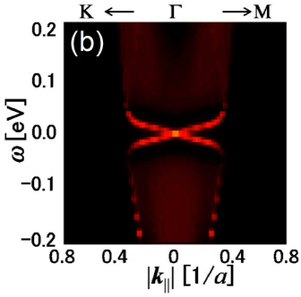
Unconventional SC States in Cu_{x}Bi₂Se₃
Δ₂ : Odd parity, full gap
Yamakage et al., PRB (2012)
Helical Majorana A
Helical Majorana B
dI/dV for A
dI/dV for B
Hsieh & Fu, PRL(2012)
Δ₄ (Δ₃) : Odd parity, point node
ZBCP due to helical Majorana fermions?
Helical Majorana C
dI/dV
Sasaki, Ando et al., PRL (2011)

Slide 11
Controversy in Cu_{x}Bi₂Se₃
Conventional s-wave ?
STM
If the bulk is BCS s-wave
Parity mixing of pair potential is anomalously enhanced by surface Dirac fermions
Opening of an additional surface gap which is larger than the bulk gap
?
Levy et al.,
PRL (2013)
E_{F}
Mizushima, Yamakage,
Sato & Tanaka, PRB (2014)

Slide 12
Controversy in Cu_{x}Bi₂Se₃
Lahoud et al.,
PRB (2013)
Mizushima et al., arXiv:1311.2768
n ≈ 10¹⁷ cm⁻³
10¹⁹ cm⁻³
10²⁰ cm⁻³
Levy et al.,
PRL (2013)
n = 4 × 10¹⁷ cm⁻³
Quasi-2D TSC?
n = 2 × 10²⁰ cm⁻³

Slide 13
Superconducting Doped TCI

Slide 14

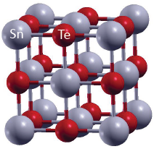
Topological Crystalline Insulator SnTe
: contribution from Te p-orbital
Band inversion + Mirror symmetry
→ Nontrivial Mirror Chern number
SnTe
PbTe
Tanaka, Sato, Ando et al.,
Nature Physics (2012)
k_{y}
Λ₃
Λ₄
-
π
+
SnTe
Λ₁
-
Λ₂
+
π
0
k_{x}
Z₂ invariant ν = 0
PbTe
SnTe
Hsieh et al., Nature Commun. (2012)

Slide 15
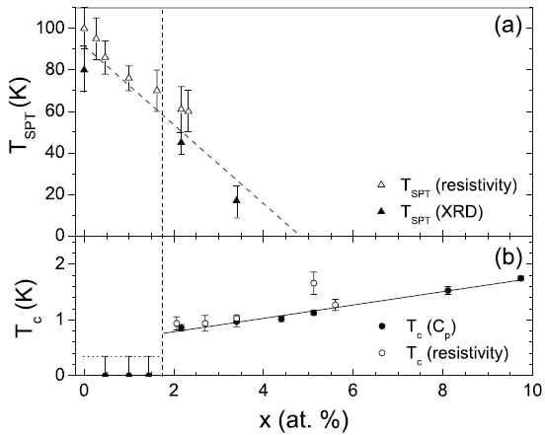
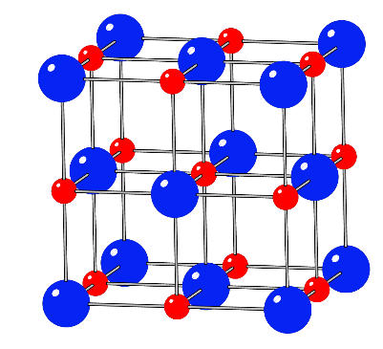
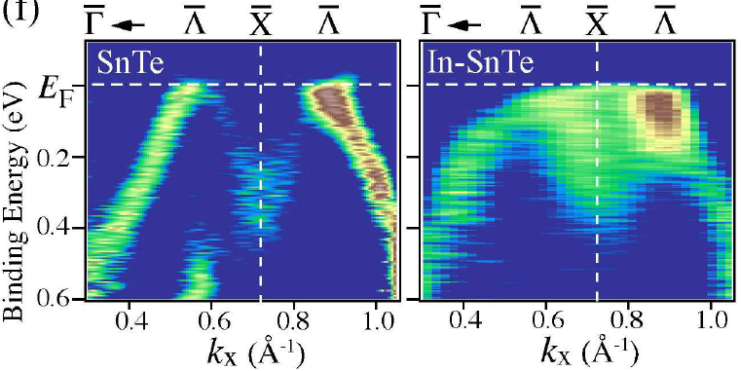
In-doped SnTe Superconductor
Rhombohedral
Cubic
Novak, Ando et al.,
PRB (2013)
Erickson et al., PRB (2009)
Sn_{1-x}In_{x}Te
Ferro-
electric
Sn²⁺/In³⁺
Te²⁻
Topological SS is present in Sn_{1-x}In_{x}Te.
NaCl Structure
n = 2 – 8 × 10²⁰ cm⁻³
Sato, Ando et al., PRL (2013)

Slide 16
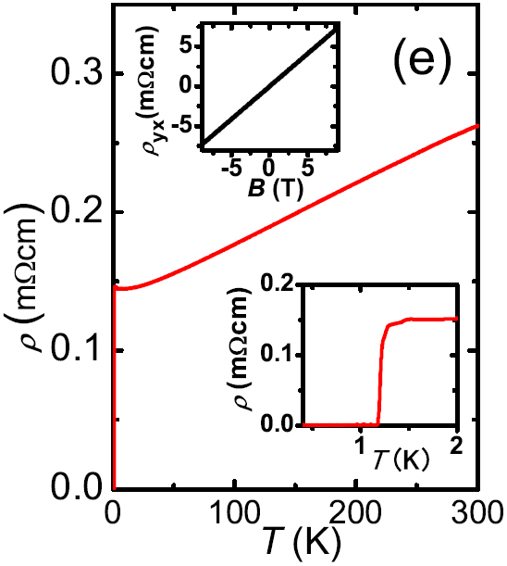
In-doped SnTe
Sasaki, Fu, Ando et al., PRL (2012)
Point-Contact Spectroscopy
0.24 meV ≈ 2Δ
Sn_{1-x}In_{x}Te
T_{c} = 1.2 K
T- dep.
(x = 0.045)
Normalized ZBCP height is > 2 !!
Faceted (001) surface
Surface Andreev Bound State due to Unconventional SC
B- dep.
Peak suppression
corresponds to H_{c2}

Slide 17
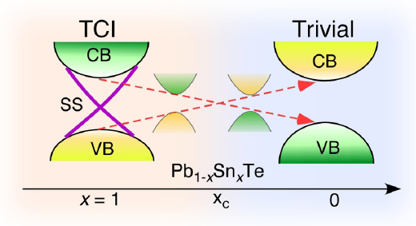
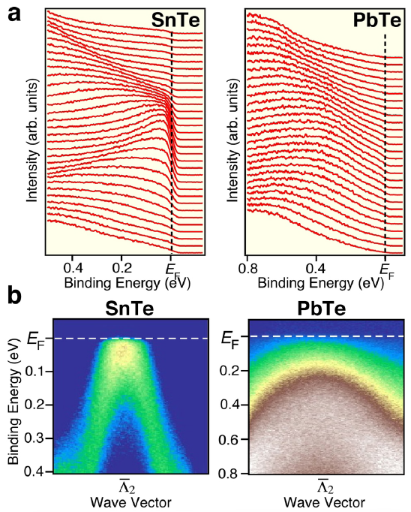
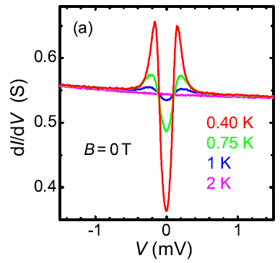
SnTe vs. PbTe
SnTe
PbTe
Similar FS structures, but the band parities are different.
Sn_{1-x}In_{x}Te
Pb_{1-x}Tl_{x}Te
Unconventional
Conventional
T- dep.
T- dep.
Tanaka, Ando et al., Nature Phys. (2012)

Slide 18
Possible SC States in Sn_{1-x}In_{x}Te
k⋅p Hamiltonian of SnTe around each L point
Topological SC?
σ_{z} = ±1 → p orbitals of Sn and Te with opposite parity
( k₃: along ΓL, k₁: along LK )
k⋅p Hamiltonian of Bi₂Se₃ around Γ point
σ_{z} = ±1 → Se p_{z} orbitals on the top and bottom layer
Sasaki, Fu, Ando et al.,
PRL (2012)
Possible Pairing Symmetry
(representations of D_{3d} group)
A_{1g}
A_{1u}
A_{2u}
E_{u}
Parity
even
odd
odd
odd
Topologically non-trivial

Slide 19
Possible SC States in Sn_{1-x}In_{x}Te
Rhombohedral
Cubic
Novak, Ando et al.,
PRB (2013)
Topological SC?
Sasaki, Fu, Ando et al.,
PRL (2012)
Possible Pairing Symmetry
(representations of D_{3d} group)
A_{1g}
A_{1u}
A_{2u}
E_{u}
Parity
even
odd
odd
odd
Topologically non-trivial

Slide 20
Majorana Zero Mode in Vortices?
If the bulk SC is conventional:
Cu_{x}Bi₂Se₃
Majorana zero mode in vortices
Sn_{1-x}In_{x}Te
Multiple Majorana zero modes can coexist due to additional symmetry to protect them from hybridization
Hosur et al., PRL (2011)

Slide 21
Natural Heterostructure

Slide 22
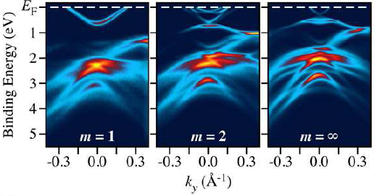
Natural Heterostructure PSBS
[(PbSe)₅]_{n}[(Bi₂Se₃)₃]_{m}
n = 1
(Bi₂Se₃)
m = 1
m = 2
m = ∞
“Quintuple Layer”
(Bi₂Se₃)
Nakayama, Sato, Ando et al., PRL (2012)

Slide 23
Natural Heterostructure PSBS
Nakayama, Sato, Ando et al., PRL (2012)
m = 1
m = 2
m = ∞
Surface states are encapsulated by the insulating PbSe layer
“Surface states” in every (Bi₂Se₃)_{m} units?
Ultra-thin Bi₂Se₃ Films
Quasi-2D system with topological “bulk” state !!
Y. Zhang, Q.K. Xue et al., Nat. Phys. (2010)

Slide 24
Cu-intercalation to PSBS m = 2
Sasaki, Segawa, Ando, PRB (2014)

Slide 25
Nearly 100% Volume Fraction
Sasaki, Segawa, Ando
PRB (2014)
Specific-heat behavior is very different from BCS, suggesting a gap with line nodes

Slide 26
Reproducibility
Sasaki, Segawa, Ando
PRB (2014)
C_{el}(T) is reproducible in two high-volume-fraction samples.

Slide 27
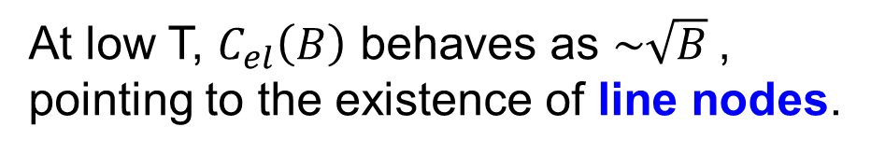

Magnetic-Field Dependence of C_{el}
$${∆C}_{el} \sim \sqrt{B}$$
Sasaki, Segawa, Ando
PRB (2014)
At low T, $C_{el}\left(B\right) \text{behaves} \text{as} \sim \sqrt{B}$, pointing to the existence of line nodes.

Slide 28
Implications of Cu-PSBS
Nodal Gap → Unconventional SC
None of the previously known superconducting TI presented clear bulk signature of unconventional SC
Sign Changing Gap + Strong Spin-Orbit Coupling → Spin-split surface Andreev bound state (i.e. Helical Majorana fermions)
Quasi 2D-Fermi surface → Majoranas are on the side
surface or terrace edge
d-wave gap

Slide 29
SrPtAs

Slide 30
SrPtAs

Slide 31
Stronger relaxation in the SC state
Appearance of spontaneous magnetic field
TRS breaking
T-dependence of penetration depth
Full gap
d+id (chiral d-wave) pairing ?

Slide 32
Thank you!

