Slide 1
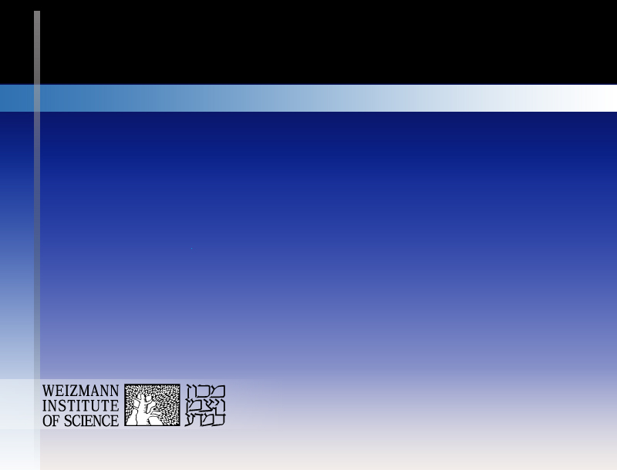
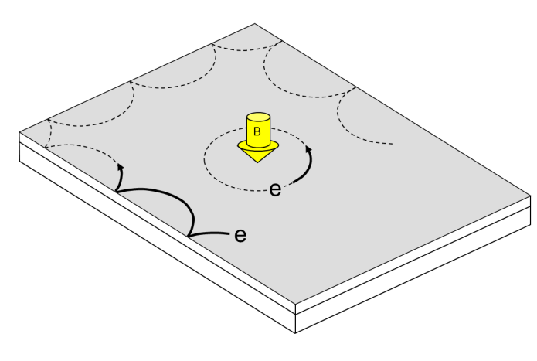
Edge States in QHE Regime …. their nature & use
basics of edge channels in IQHE
doing physics with integer edge channels
studies of transport in FQHE regime
deviations from the ‘accepted’ picture
Moty Heiblum

Slide 2
edge channels in FQHE
mirrors of the bulk
back to shot noise…

Slide 3
shot noise T > 0
V = 0 ……….. S_{i} (0) = 4k_{B}Tg ……….thermal
noise of independent scattering
T = 0 ……….. S_{i} (0) = 2qI (1-t )……..shot
E_{F}
T=100mK
E_{F}
n (E )
n (E )
V , T > 0 …………………………………….total

Slide 4
start with ν =1/3…a reminder
ohmic contact
Φ₀
r
J (r )
=e / 3

Slide 5
start with, ubiquitous v =1/3 fractional state
conductance is not enough - use shot noise
employ partition via weak backscattering
→ infrequent & independent events - stochastic
determination of qp charge

Slide 6
similar conductance - different shot noise
g =e ²/ 3h
noise → e* = e
partitioning
e
e
e
t
h/eV
g =e ²/ 3h
e / 3
e / 3
e / 3
noise → e* =e/3
t
3h/eV

Slide 7
extremely weak backscattering T=9mK
1-t ~ 0.01
V
=-0.03V
g

Slide 8
strong → weak backscattering
only electrons
expected
e
e/3

Slide 9
composite edge channel ν =2/5

Slide 10
extremely weak backscattering
1-t ~ 0.01
ν = 2/5
bunching of quasiparticles
charge = filling factor

Slide 11
1st excited Landau level

Slide 12
1st excited Landau level
v =5/2 Moore - Read proposed non-abelian state
- Rxx x 100
- Rxy
R ( kΩ )
ν=2
ν=5/2
ν=7/3
ν=3
ν=8/3
B ( T )
μ ~ 30⋅10⁶ cm²/V-s

Slide 13
charged quasiparticles v=5/2 FQHE state
v = 5/2 → 2 + 1/2
R_{xx} = 0
R_{xy} quantized
→ energy gap
e
e
composite fermions at B* =0
single spin (high field)
p-wave superconductor…. Moore-Read state
predicted Majorana qp’s: localized in the bulk and propagating in chiral edge modes

Slide 14
v = n +1/2
2φ₀
2φ₀
ν =5/2 = 2+1/2
e
e
composite fermions at B =0
metal
superconductor
exotic phases
R_{xx}=0
p-wave superconductor

Slide 15
expected charge of excitations
Cooper pairs
  J_{r}
  r
-
-
-
-
-
+
+
+
-
-
+
+
ε
+
-
-
+
+
+
  ϕ
-
-
-
-
-
Notes:
Now we would like to show how an excitation can be formed in a FQH system, and find its charge. We will show that these excitations have a fractional charge, and try to relate them to the CFs we talked about earlier.
Let us assume that the 2d system is set in a FQH state of filling factor nu. The long and transverse cond. Are the following.
To demostrate the idea we will work in the polar model. Recall that the y is r and x is theta.
As before, a magnetic flux is applied to the system in addition to the uniform B, through a hole in the middle of the sample. The flux is varied adiabatically from 0 to phi_0.
This flux change in time generates electric field in the azimuthal direction according to dphi/dt=Edl
The resulting current is in the perp direction, since sigma-xx=0, and equals Jr=…
i.e as long as the flux continues to change, there’s current in r direction, and as it stops, a charge polarization is retained, since this hall voltage created can only generate theta-current, which will not change this charge deplition.
Lets compute this charge access.
Integrate over time the current, which is current density multiplied by the circumference.this is a simple integral which equals the integral of phi_dot over time, I.e, the total flux, phi_0. All together, it turns out that the charge is a fraction of the eletron charge.
By varying the flux adiabatically we assured that the system remains in an eigenstate (adiabatic theorem), and since we varied the flu by 1 flux quanta, the spectrum is the same as it was for zero flux.
These two facts combined lead to the coclusion that by the above procedure one creates an excitation (eigenstate different from the groundstate), with a finite life time due to zero conductivity. Such an excitation is usually called a quasiparticle, or can also be a few qp’s.
Note that since sigma-xx =sigma yy=0, the voltage created in the r-direction due to the deplition, remains even when the flux stops changing. This y-voltage cannot lead to any y-current, or at least only to an exponentially small one ➔ long living excitation=a quasiparticle, of charge Q. (may also be a bunch of qp’s.)

Slide 16
partitioning ν =5/2

Slide 17
particle-like (Laughlin) & hole-conjugate
quasiparticles

Slide 18
hole-conjugate states
source
drain

Slide 19
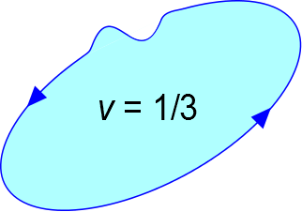
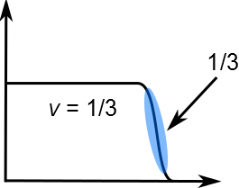
expected ν = 1/3 (particle-like)
ν
x
bulk: single component and gapped (incompressible liquid)
edge: single charge mode with G=G₀/3

Slide 20
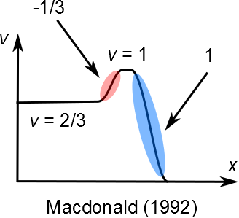
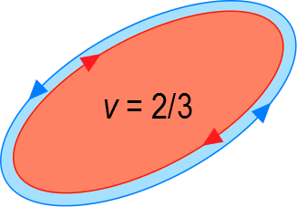
ν = 2/3 (hole-conjugate-like)
ν = 2/3 = 1 – 1/3
full LL of electrons – 1/3 holes
upstream e/3 was not found…..Ashoori 1992

Slide 21


MacDonald’s clean edge
naive model 2-probe conductance = 4/3 e²/h
neasured 2-probe conductance = 2/3 e²/h

Slide 22
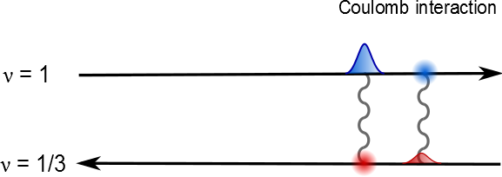
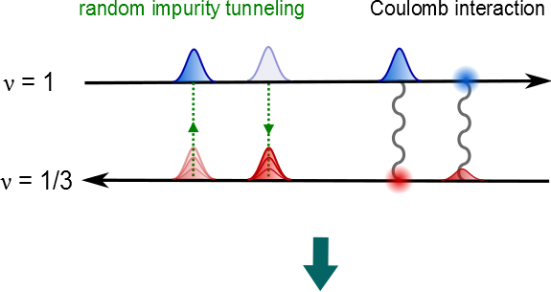
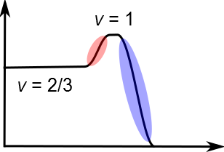
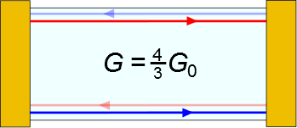
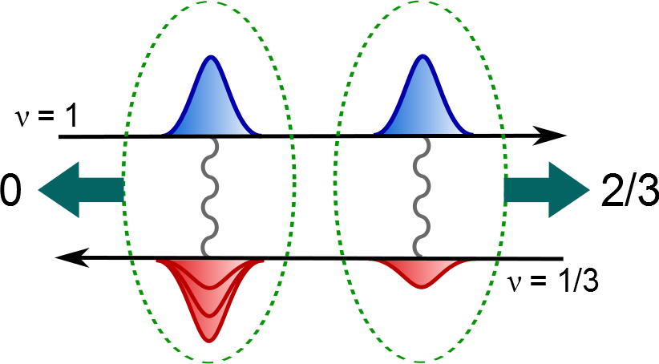
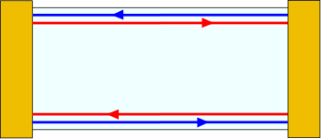
forming upstream neutral mode ν =2/3
ν = 2/3
lack of equilibration
downstream charge mode G=(2/3)G₀ + upstream neutral mode
Kane et al. 1994

Slide 23
why study neutral modes ?
    predicted but was not measured before
    an added source of energy dissipation
    a possible source of quasiparticle dephasing

Slide 24
envisioning neutral modes…
coherent (quantum) dipoles or classical heat wave…
impinged at a partitioning barrier ( QPC ; non-ideal ohmic contact ):
dipoles may fragment
leading to excess noise
temperature may rise

Slide 25
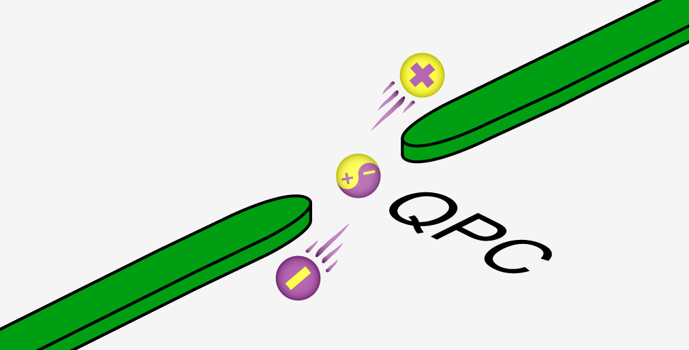
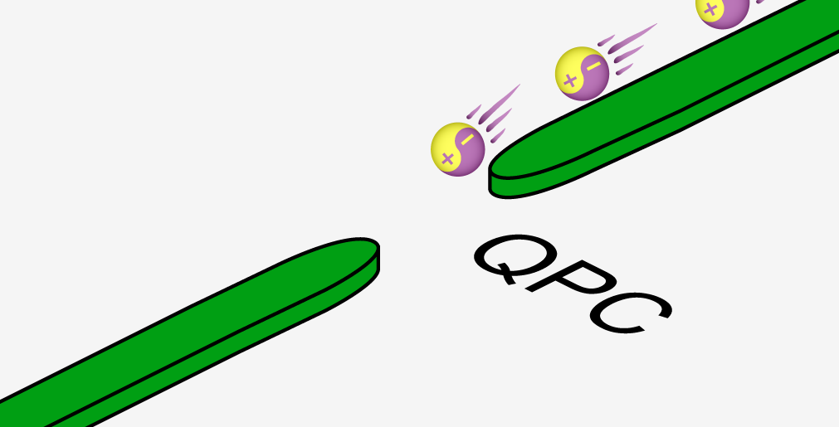
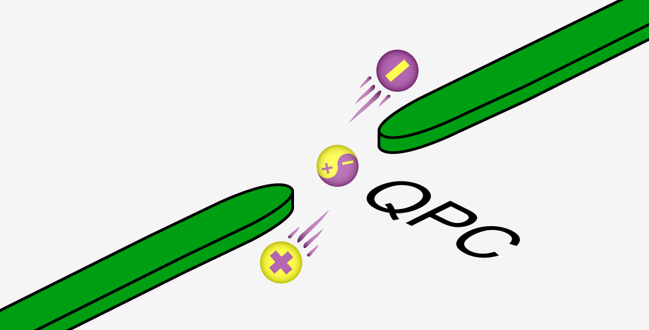
neutral mode → ‘flow of dipoles’
shot noise (electron-hole) without net current

Slide 26
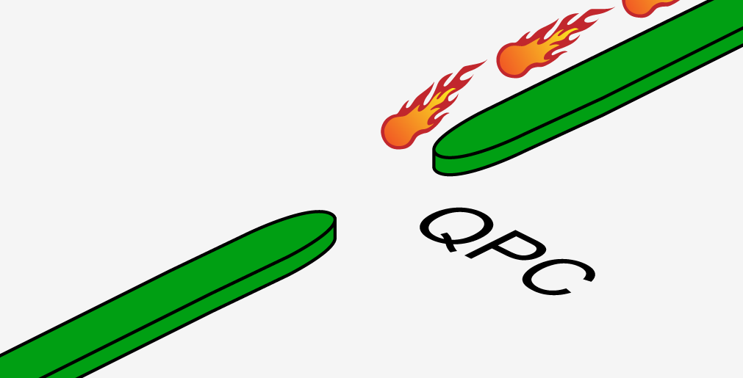
neutral mode → heating a QPC
thermal noise without net current

Slide 27
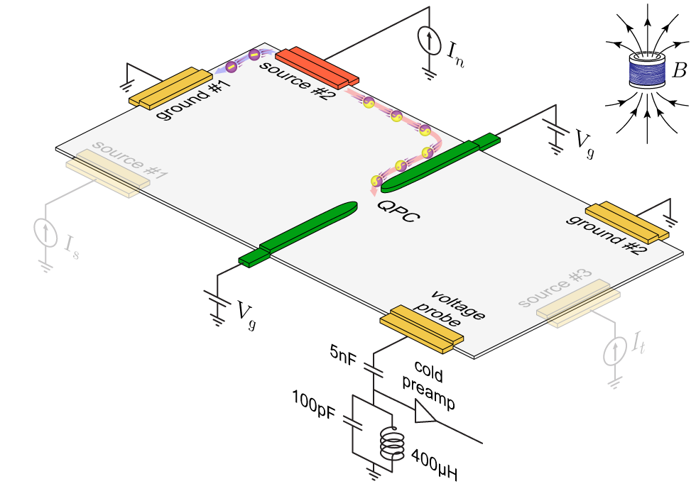
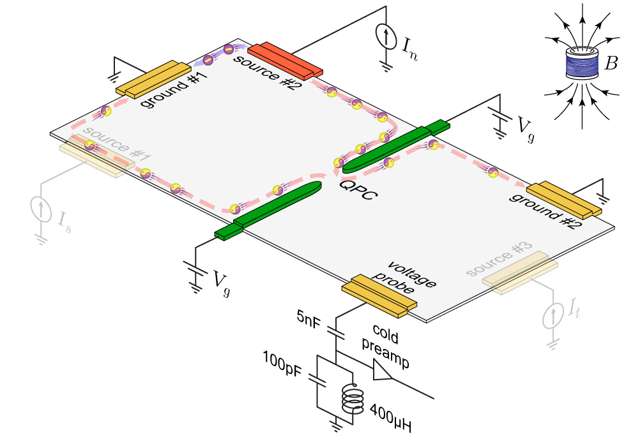
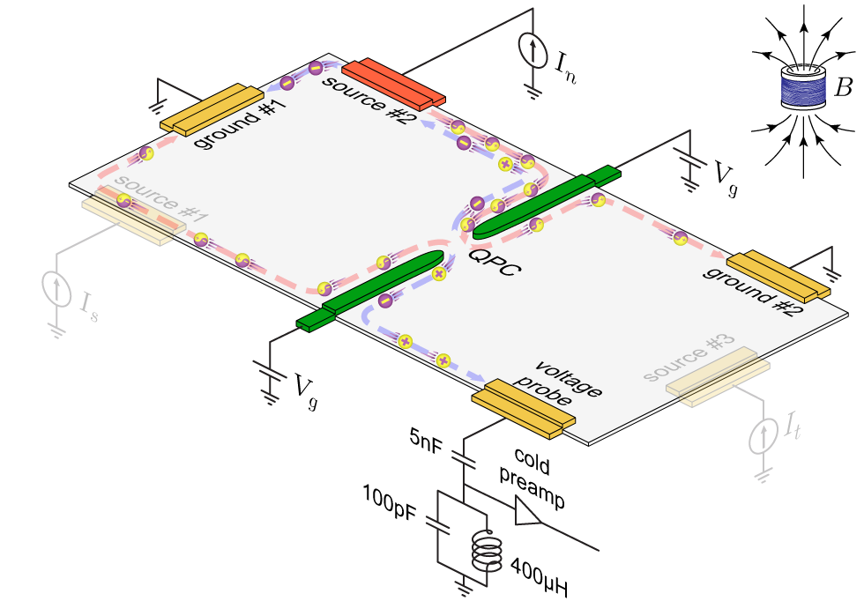
excitation of neutral mode at ohmic contact
injecting from source #2
downstream current
upstream current
qp
40μm
looking for shot noise
with zero net current

Slide 28
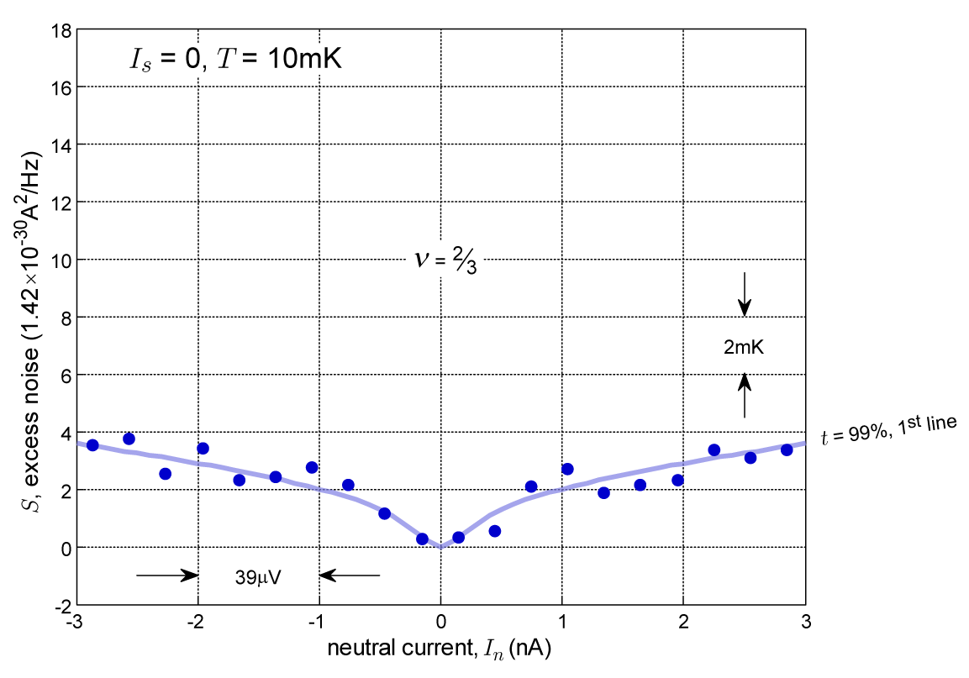
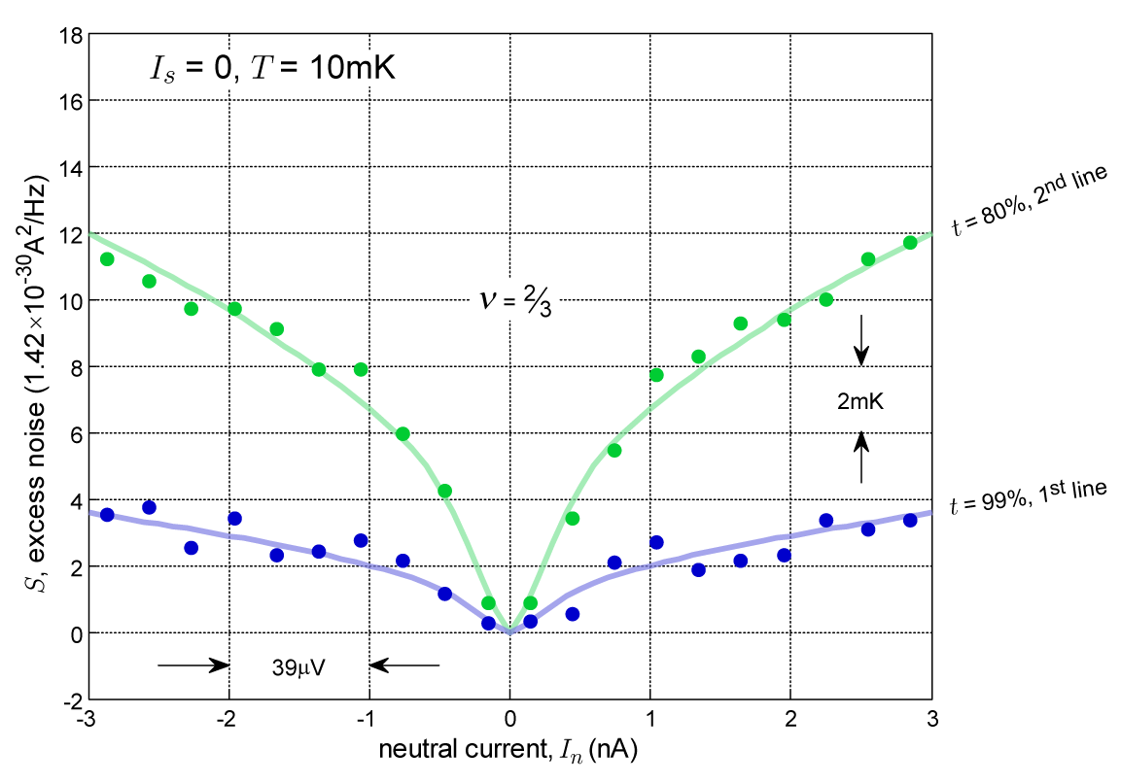
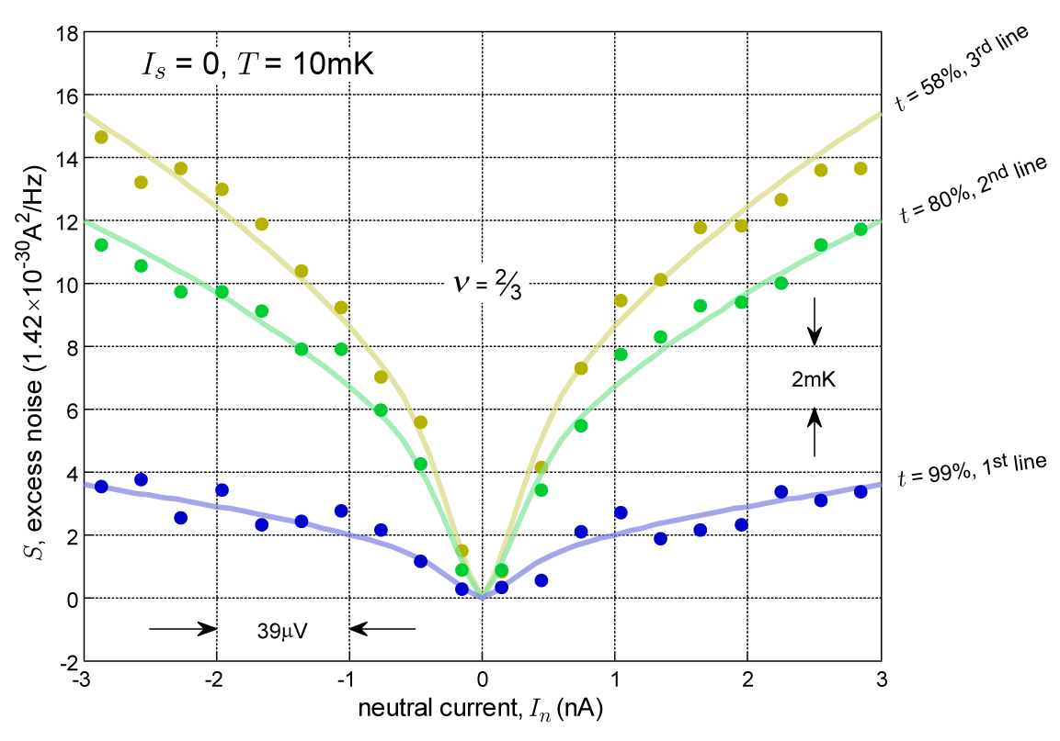
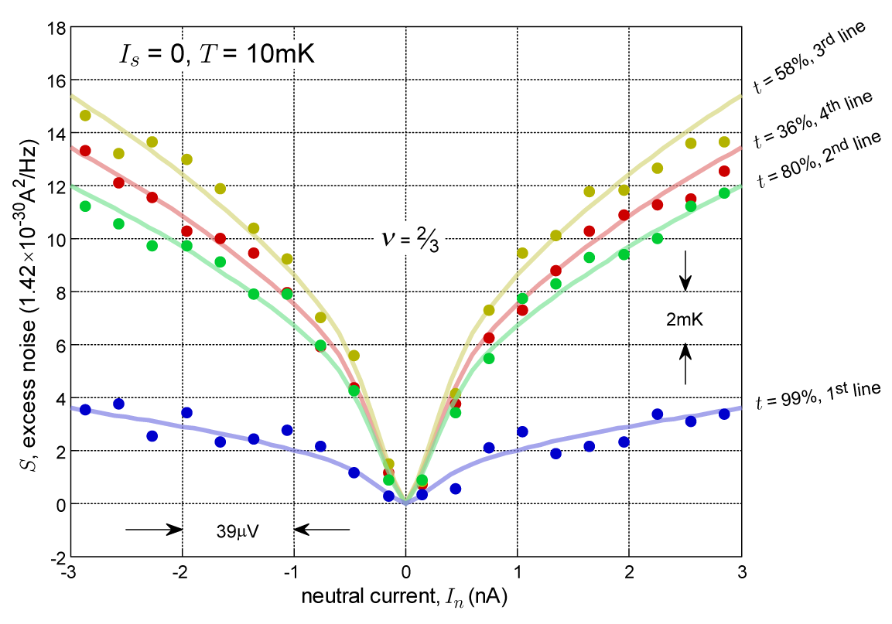
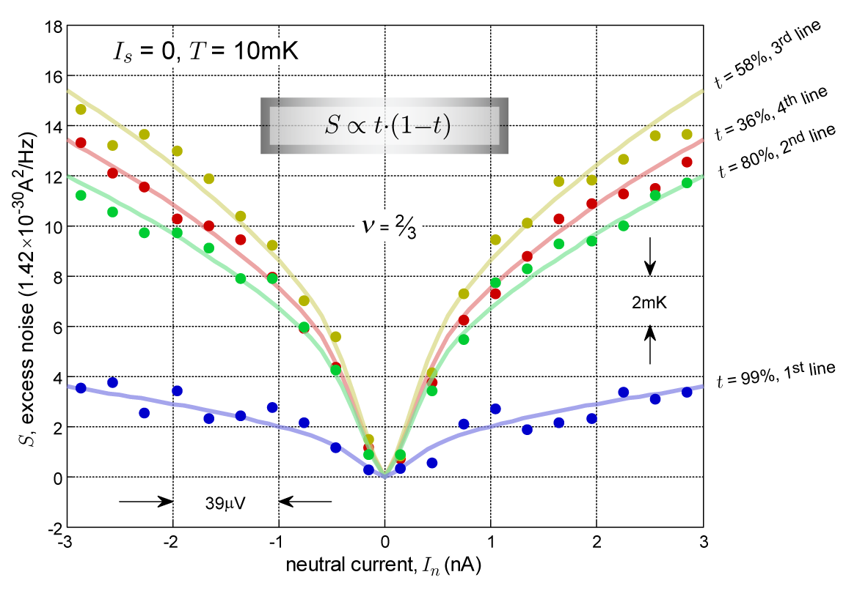
upstream noise v=2/3
10⁻²⁹A²/Hz → 7mK
transmission of QPC
t (1-t )

Slide 29
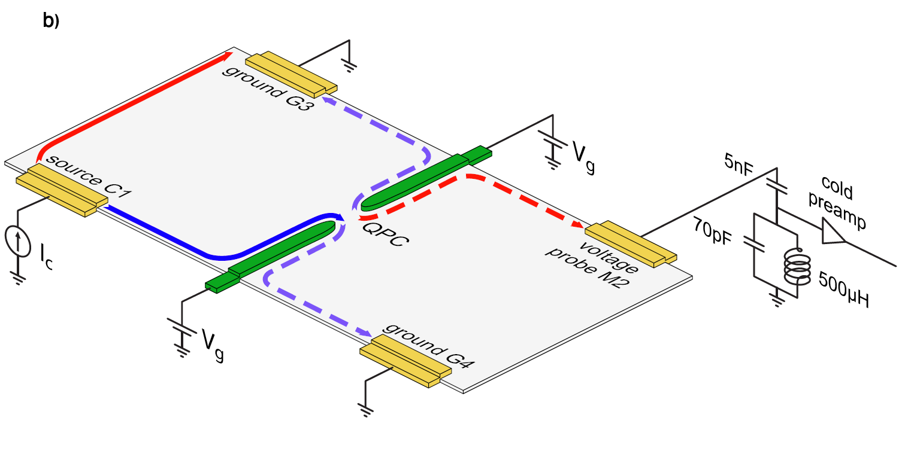
excitation of neutral mode at QPC …
qp
neutral
charge

Slide 30
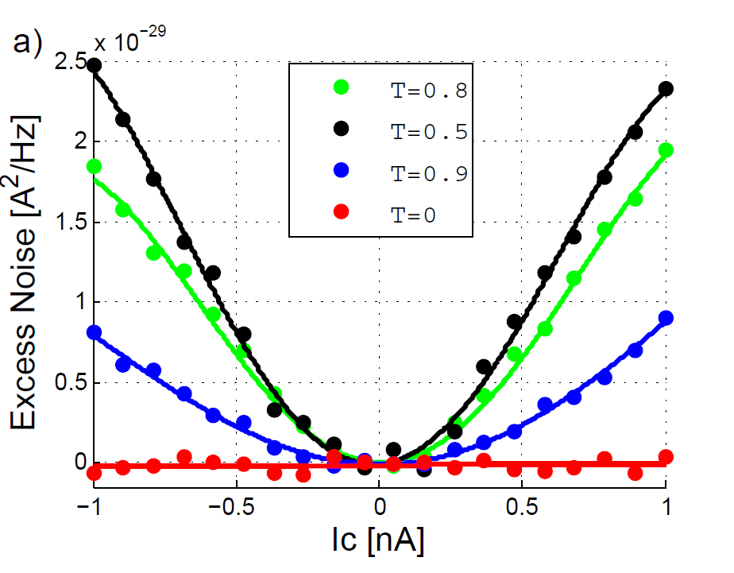
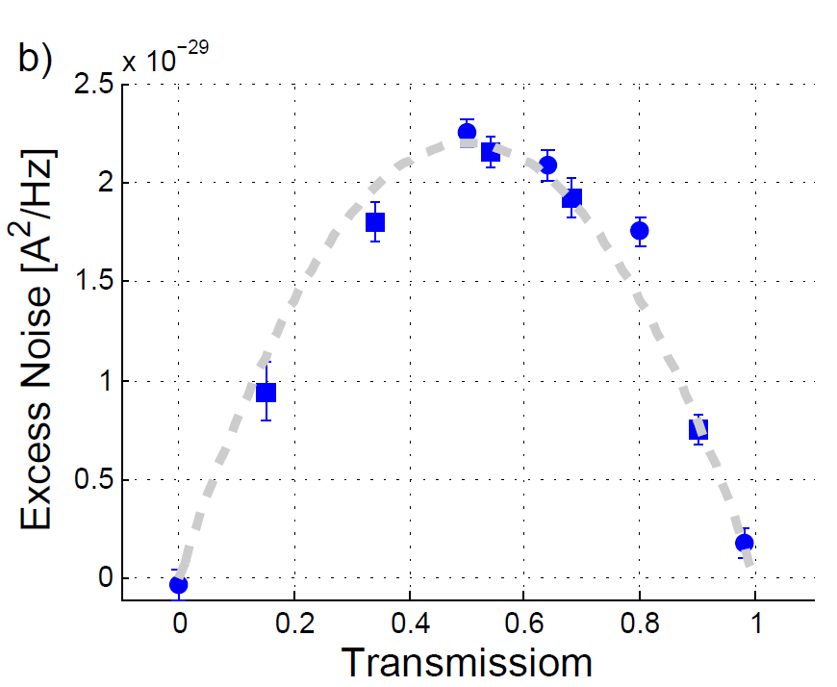
upstream noise v=2/3
noise due to neutral mode
T (1-T )

Slide 31
v = 5/2 ….. a few possible wave functions
state | statistics | charge | upstream neutral mode
Moore-Read (Pfaffian) Moore & Read, Nuclear Phys. B (1991) | non-abelian | e/4 | no
anti-Pfaffian Lee, PRL (2007); Levin et. al. PRL (2007) | non-abelian | e/4 | yes
U(1)XSU(2) Wen, PRL (1991) | non-abelian | e/4 | no
331 Halperin, Helev. Phys. Acta (1983) | abelian | e/4 | no
M.Dolev et. al., Nature 452, 829 (2008),
P. Iuliana et. al., Science 320, 899(2008),
V. Venkatachalam et. al., Nature 469, 182 (2008)
identifying wave function
Notes:
31

Slide 32
neutral mode at v = 5/2
N
→
C
1
Transmission
~t (1-t )
0.5
0
-1
-0.8
-0.6
-0.4
-0.2
0
0.2
0.4
0.6
0.8
1
/Hz]
x 10
-29
2
3
2
Excess Noise [A
1
0
-1
-0.8
-0.6
-0.4
-0.2
0
0.2
0.4
0.6
0.8
1
In [nA]
clear evidence of upstream neutral mode
favors anti-Pfaffian wave function

Slide 33
    status as of 2014…
    upstream neutral modes in hole-conjugate states and in v =5/2
    excitation when imbalance of Fermi energy
    NO upstream net current
    no neutral modes in the integer regime
    no neutral modes in particle-like states
    neutral modes decay at distance (~100μm)
    neutral modes decay at temperature (~100mK)

Slide 34
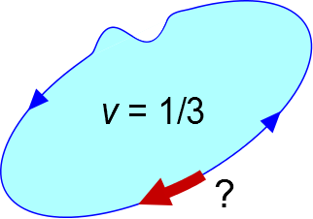
since no sign of interference of qp’s in v =1/3…
are particle-like states supporting also
unobserved neutral edge modes?

Slide 35
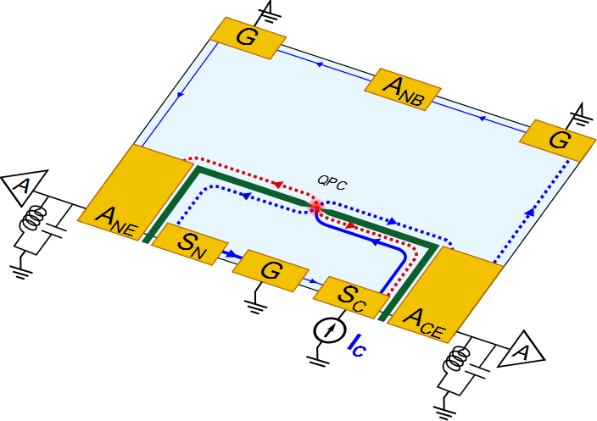
repeating the experiments:
> higher sensitivity noise measurements
> shorter distance of neutral mode propagation length > could we also have bulk contributions ?
upstream noise
at non-ideal ohmic contact
1 x 10¹¹ cm⁻² ; 5 x 10⁶ cm²/V-sec
downstream shot noise

Slide 36
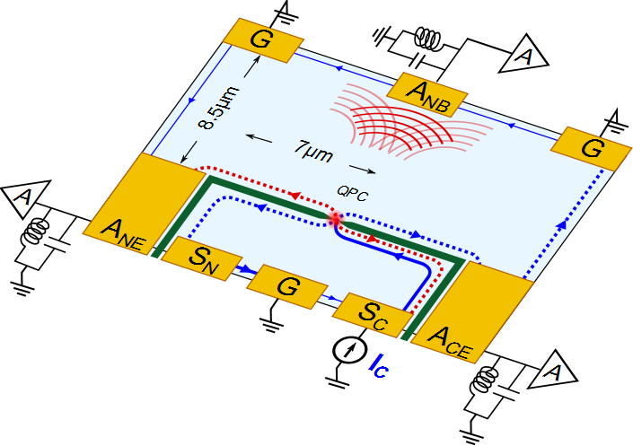
could we also have bulk contributions ?
bulk
upstream noise (?)
edge
downstream shot noise ~t(1-t )
edge

Slide 37
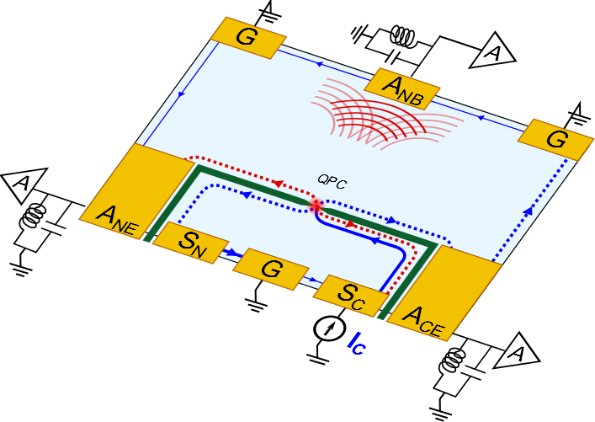
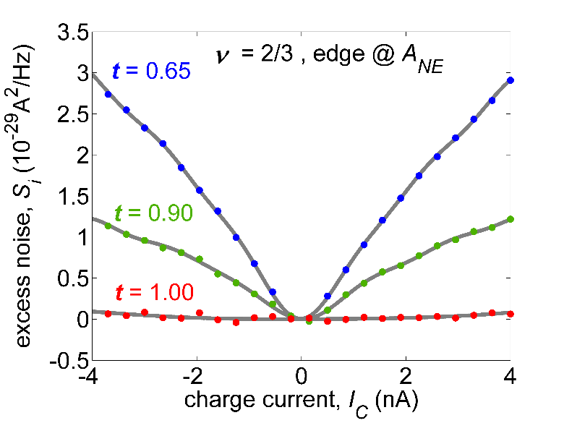
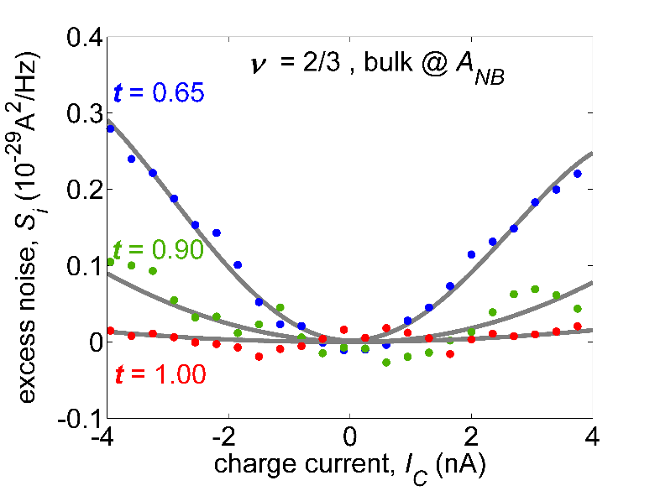
start with v = 2/3 25mK
10⁻²⁹A²/Hz → 7mK
edge
bulk
energy also propagates through the incompressible bulk !
however, most energy is carried by chiral upstream edge mode

Slide 38
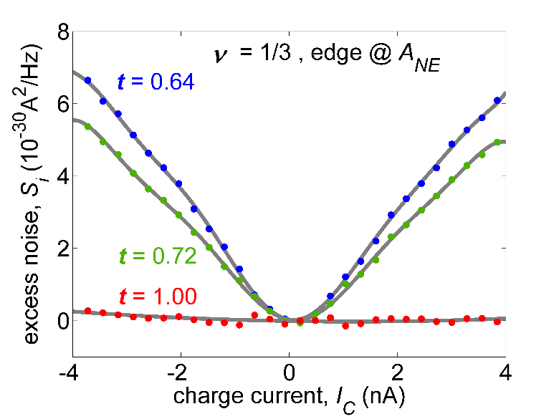
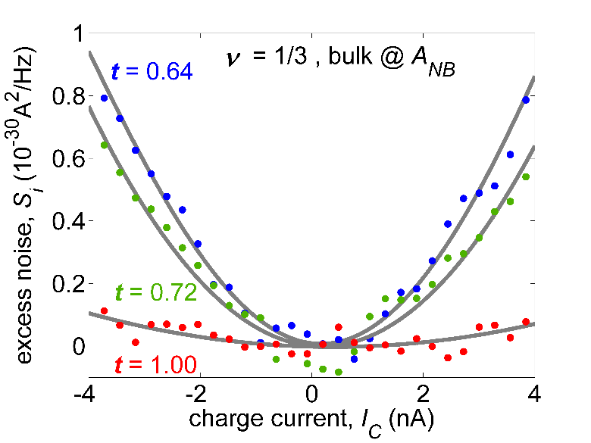
v = 1/3 25mK
edge
bulk
10⁻³⁰A²/Hz = 1.4mK
about ~5 weaker than in v =2/3
qualitatively similar results obtained in v = 2/5, 4/3

Slide 39
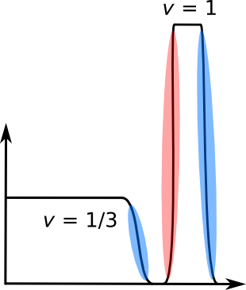
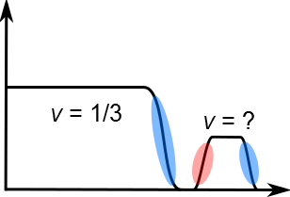
an unexpected reconstruction forms at 1/3…
ν = 1/5?
x
x

Slide 40
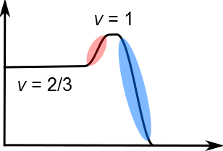
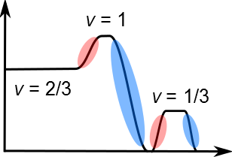
do we know the structure of v =2/3 ?
sharp - smooth edge
smoother edge ?
ν
ν
Girvin, MacDonald
Meir 1994 PRL
x
x
or, could it be ?
v =2/3
v =1/3
v =1/3
initial evidence of thus reconstruction…

Slide 41
    upstream neutral modes in hole-conjugate states and in v =5/2
    excitation when imbalance of Fermi energy
    NO upstream net current
    no neutral modes in the integer regime
    no neutral modes in particle-like states
    neutral modes decay fast with distance (~100μm)
    neutral modes decay fast with temperature (~100mK)
    neutral modes in the bulk
    nature of the modes is not clear (incoherent heat wave, coherent dipoles,…)

Slide 42
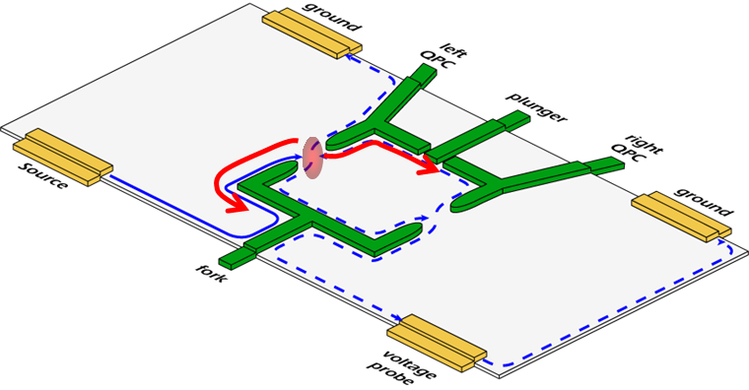
lack of interference of qp…..
      small edge velocity → extended duration in interferometer
      interaction with uncontrolled environment
      small edge velocity (small electric field) → level spacing < k_{B}T
      built-in ‘which path’ detection via the ‘neutral modes’
increasing edge velocity………….sharpening the edge
eliminating edge reconstruction somehow ?

Slide 43
thank you

