Slide 1
the world of 2d electrons is exciting:
enabling ‘ballistic high mobility transport’ modulation doping
easy electrostatic control close to surface
unique excitations (quasiparticles)

Slide 2
exchange statistics in the
2d world
richer than the 3d world

Slide 3
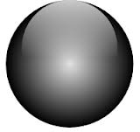
exchange statistics in 3d
bosons
fermions
both

Slide 4

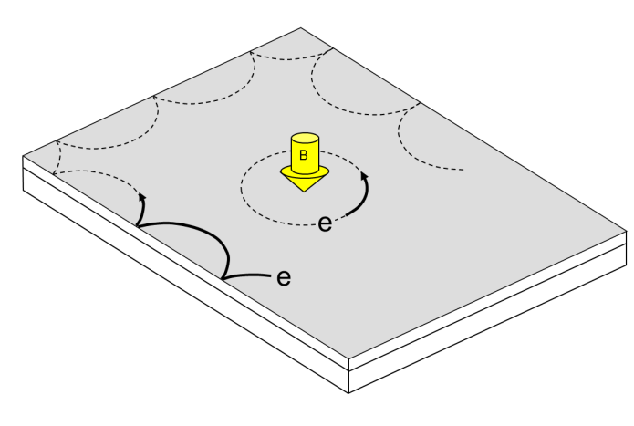
Edge States in QHE Regime …. their nature & use
basics of edge channels in IQHE
doing physics with integer edge channels
studies of edge transport in FQHE regime
deviations from the ‘accepted’ picture
Moty Heiblum

Slide 5
doing physics with edge channels
interference

Slide 6
interference with edge channels - why ?
edge channel encloses a definite area
minimizes phase averaging, high visibility fringes
electrons directed along definite paths
flexible design
no back-scattering insensitive to impurities

Slide 7
how to fool edge channels to interfere ?
X
B
will not interfere

Slide 8
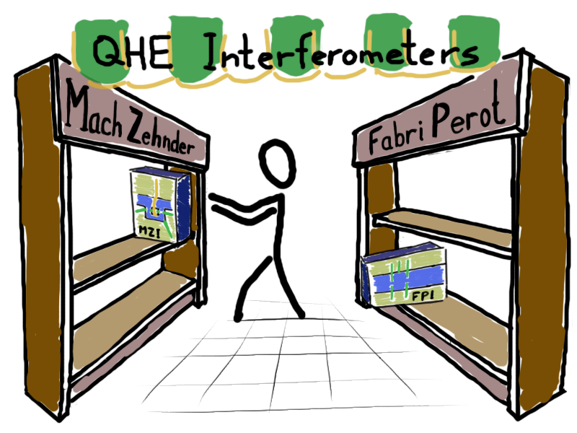
y

Slide 9
Mach - Zehnder

Slide 10
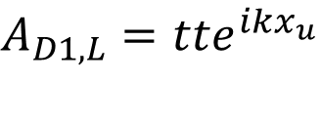

optical MZI
interference observed as function of the path difference
$$A_{D1,L}=tte^{ikx_{u}}$$
$$+ rre^{ikx_{d}}$$
$${\left|A_{D1,L}\right|}^{2}=T^{2}+R^{2}+2RT\cos{k\left(x_{d}−x_{u}\right)}$$
0
1π
2π
3π

Slide 11
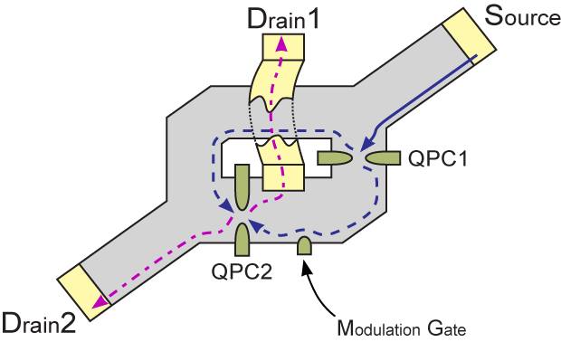
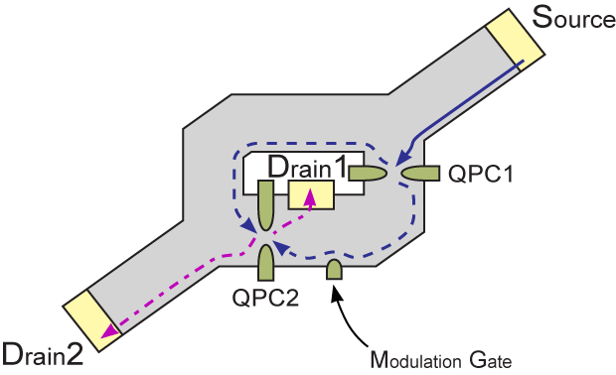

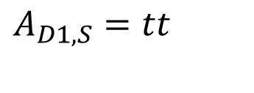

electronic MZI
(2,0)
interfering the lowest Landau level
$$A_{D1,S}=tt$$
$$+ rre^{i2πAB}$$
$${\left|A_{D1,S}\right|}^{2}=T^{2}+R^{2}+2RT\cos\left(2πAB\right)$$

Slide 12
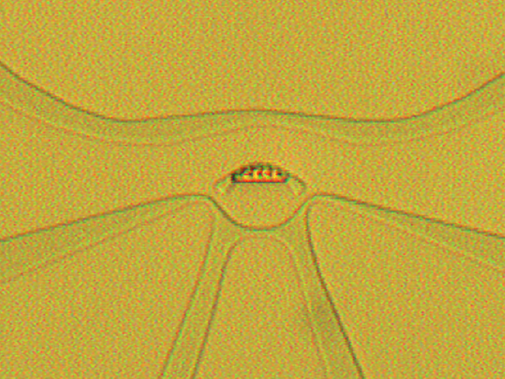
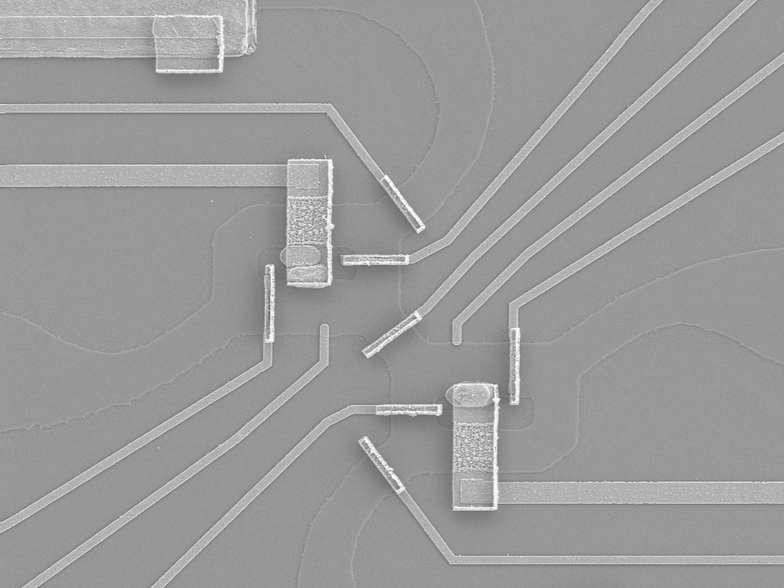
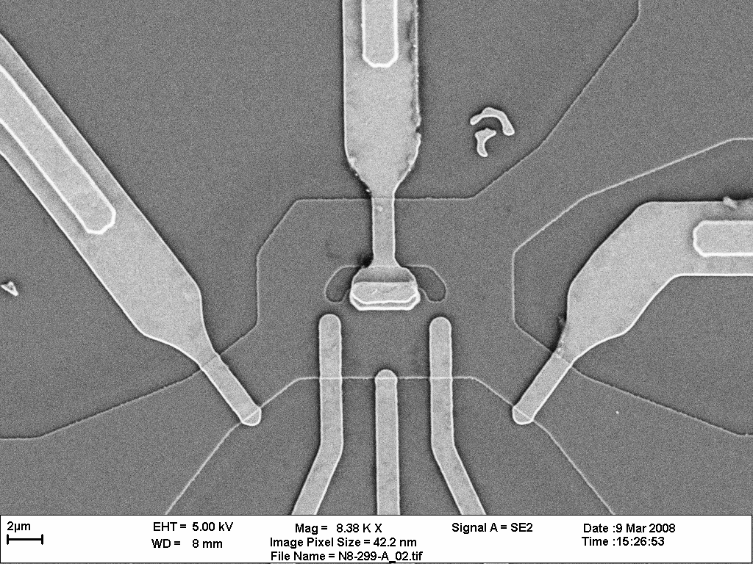
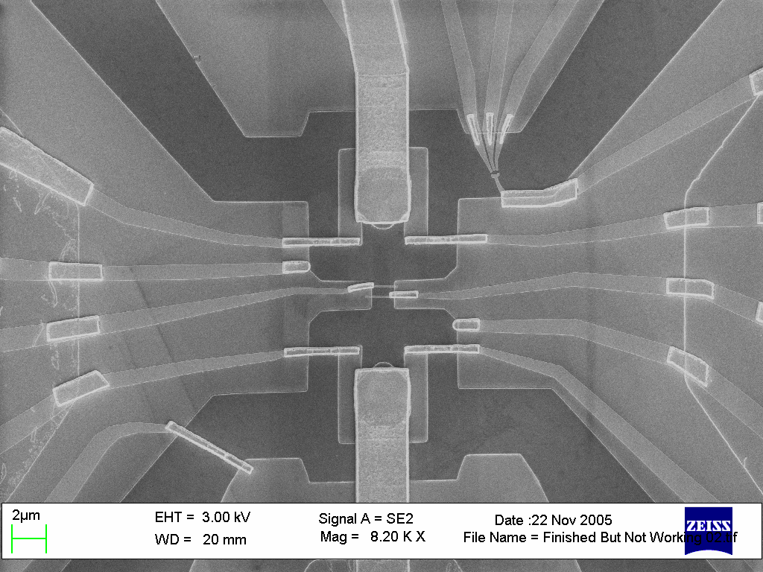
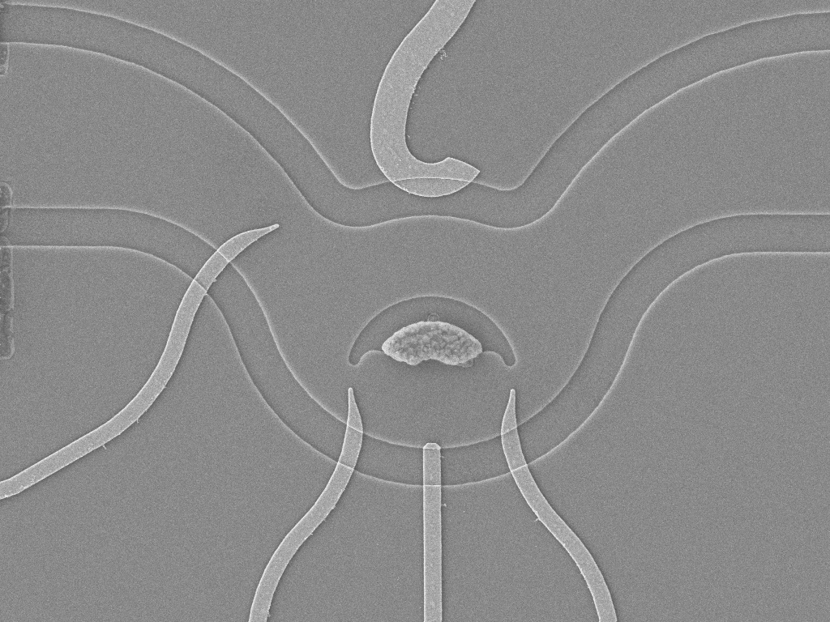
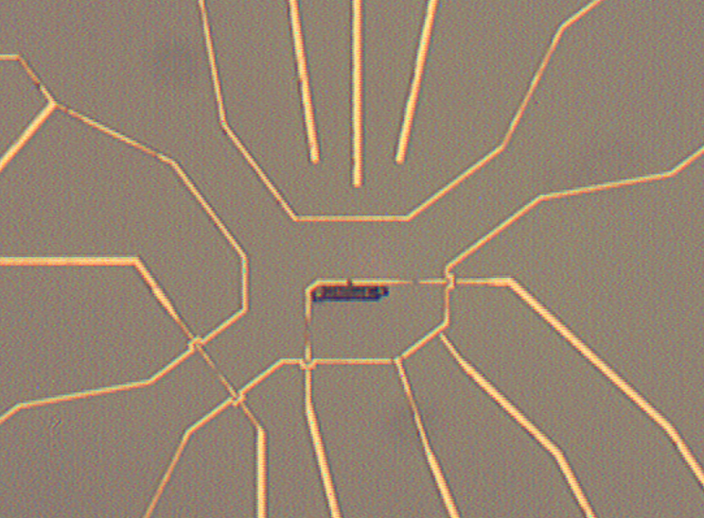
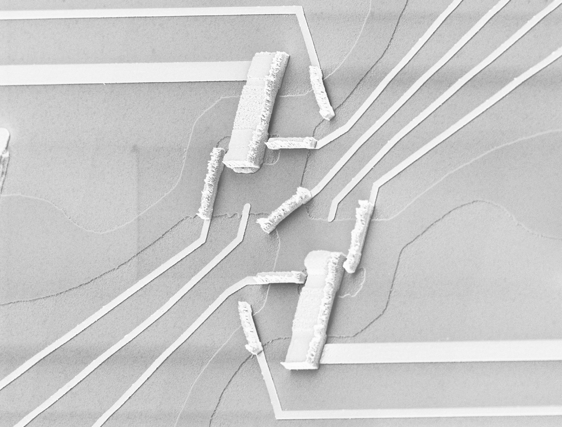
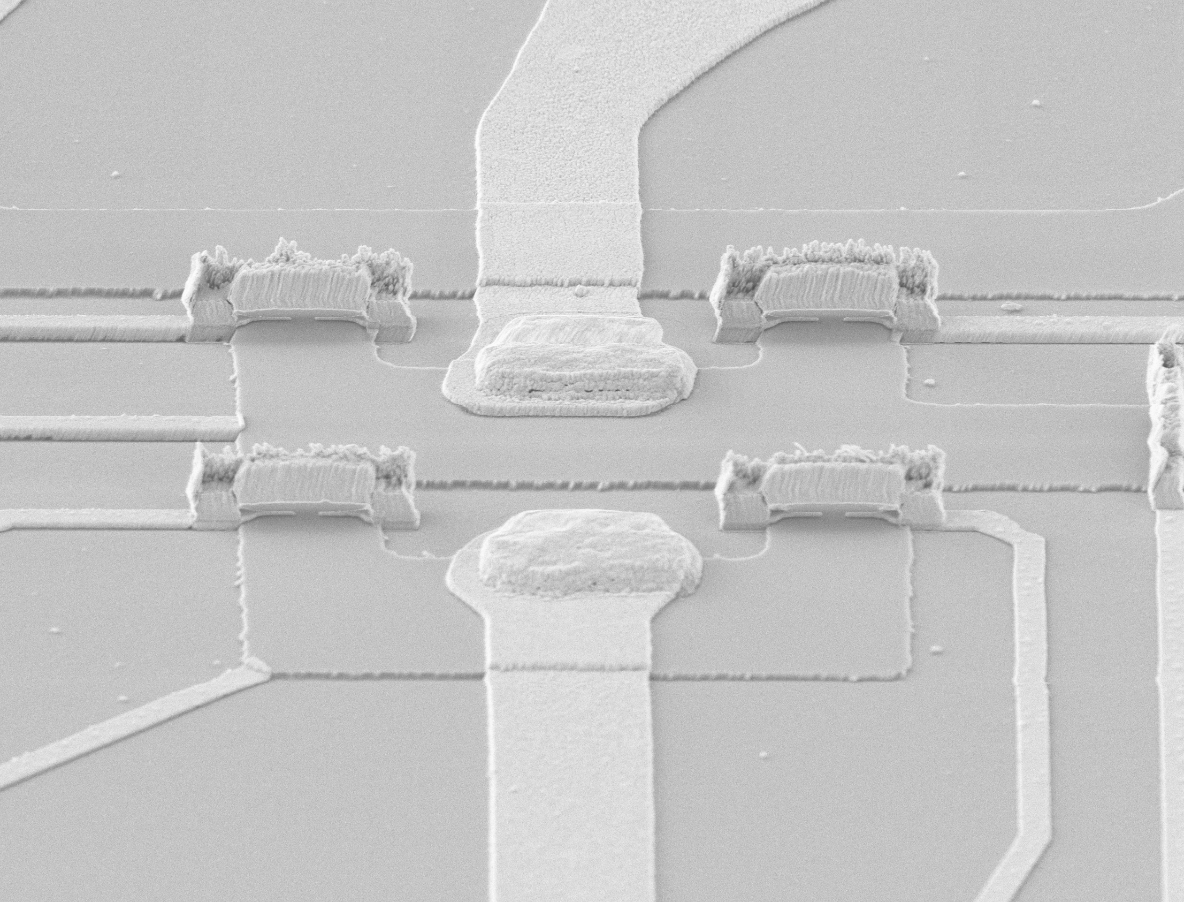
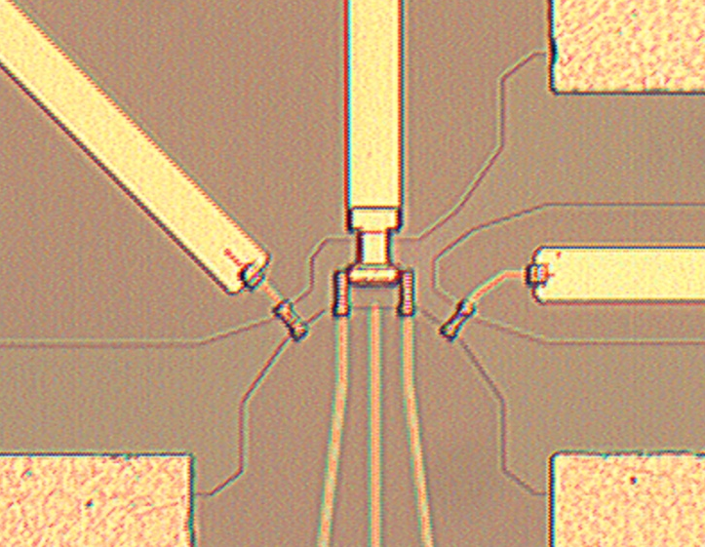
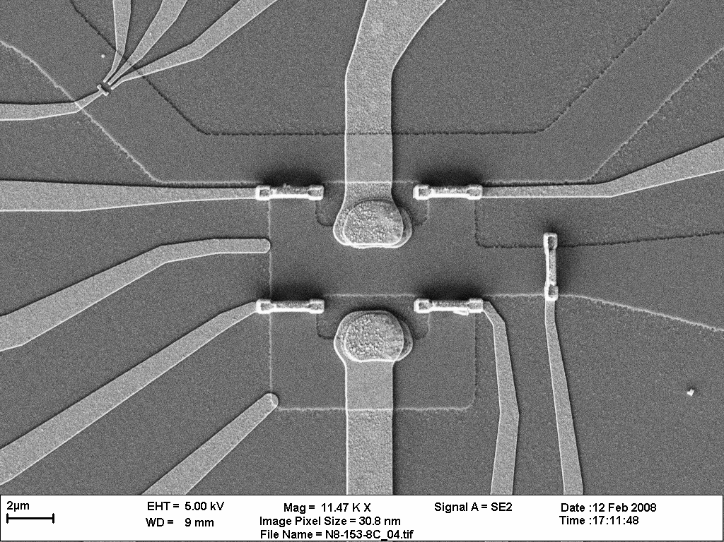
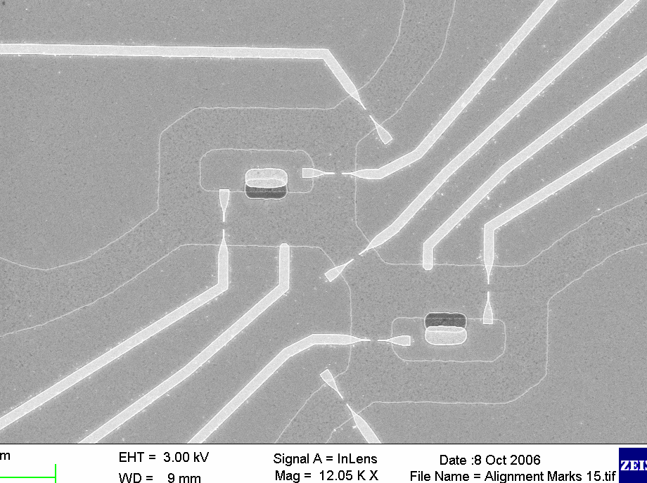

Slide 13
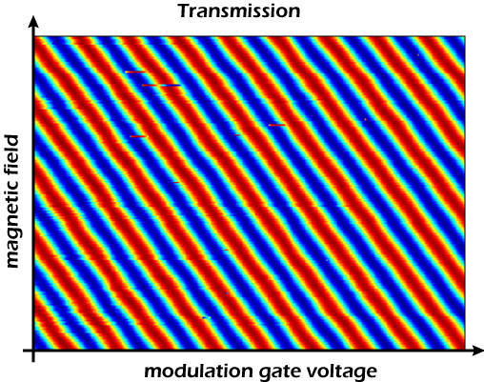
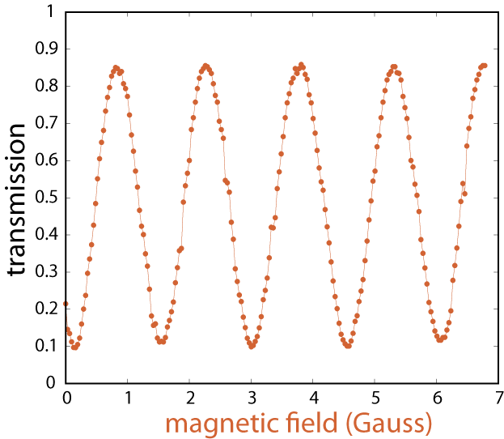
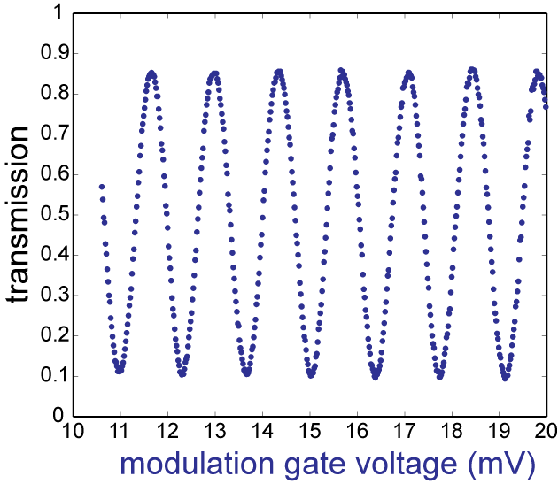
Aharonov – Bohm interference (AB)
ΔB (φ₀) ~ 1gauss
via natural decay of B
mind the slope…
via modulation gate MG
AB area = geometrical area

Slide 14
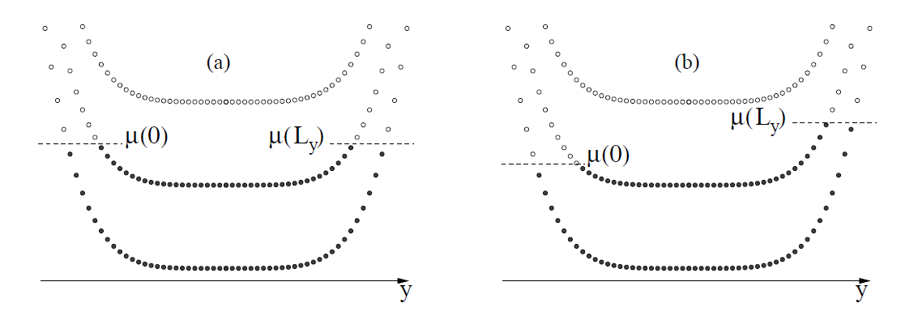
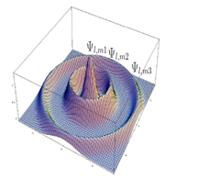
a different look at AB…. tunneling to edge states every φ₀
filling factor = 1.5
E_{F}
tunneling in
tunneling out
increasing B
states slide downhill inwards
Fermi energy in the gap (between states)
conductance goes down
N ^{th} state
compressible
incompressible
(N-1)^{th} state

Slide 15
strong screening in MZI
B, N electrons
B+ΔB, N electrons
positive charge
donors
at empty state
compressible electrons
negative charge
partly filled edge state
when empty states cross the Fermi energy – they partly filled by lead electrons
under the Fermi energy states are filled by electrons from the bulk
outer state at ~constant area ---- periodic AB oscillation
total number of electrons fluctuates N….N+1

Slide 16
Fabry - Perot

Slide 17
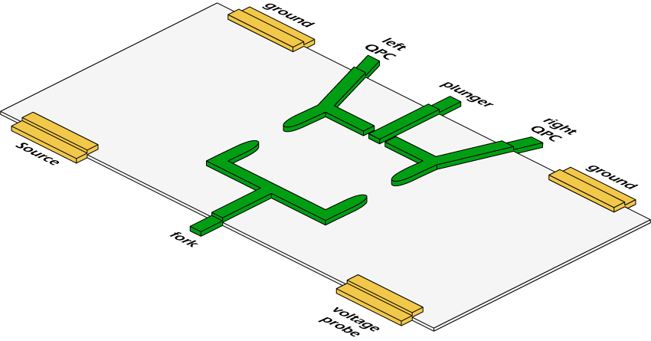



electronic FPI
optical FPI
BS
S
in the limit of only two-path interference

Slide 18
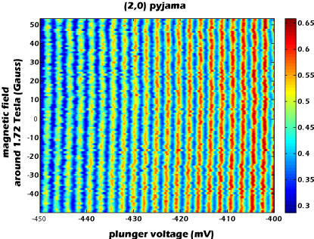
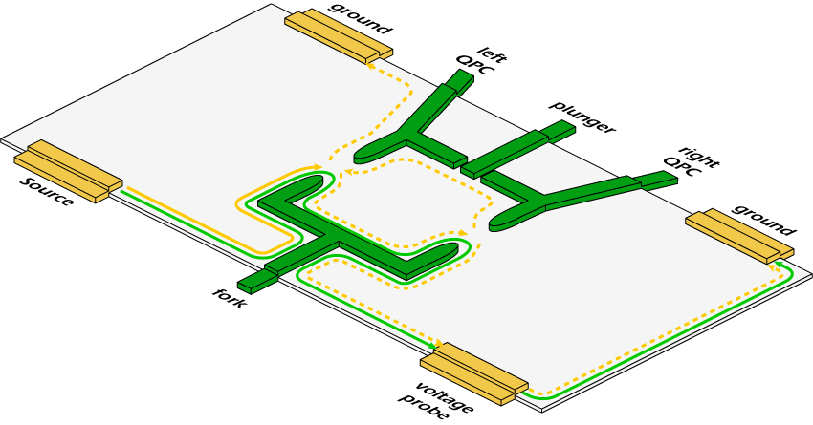
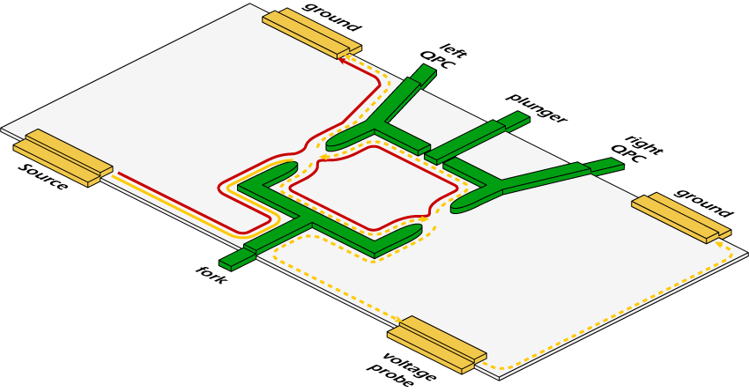
bare FPI – is Coulomb dominated (CD)
(2,0)
interfering the lowest Landau level
no B dependence
flux remains constant

Slide 19
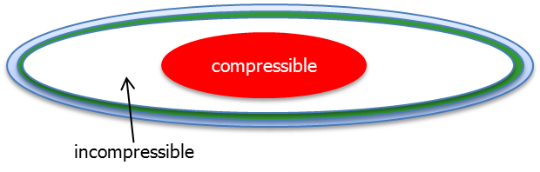
CD dominated
c<<
c<<
c>>
N ^{th} state
small charging energy between bulk and edge
large charging energy to the leads

Slide 20
FPI in CD regime – no sufficient screening
filling factor = 1.5
A
B
E_{F}
electrons cannot be added from the leads
number of electrons in outer state = constant
hence, all states shrink
(A -ΔA )(B +ΔB )= constant
after φ₀ a new empty state forms in the lowest LL
electron is added to outer state from bulk
A-ΔA
B +ΔB
E_{F}
Halperin et al., PRB 2011

Slide 21
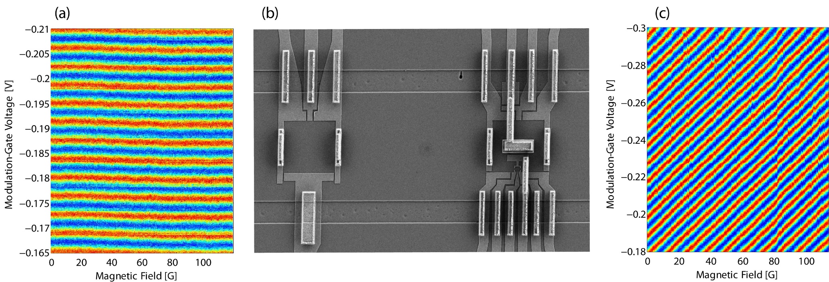
MZI
FPI
increasing area

Slide 22
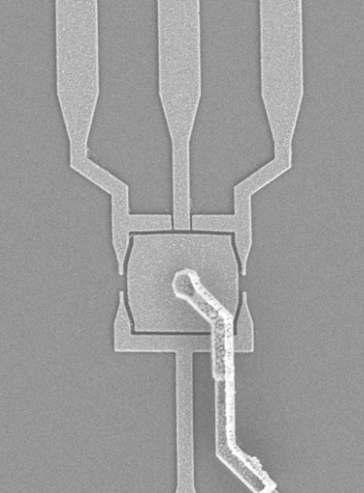
FPI from CD to AB
adding:
-- grounded ohmic contact
-- top gate

Slide 23
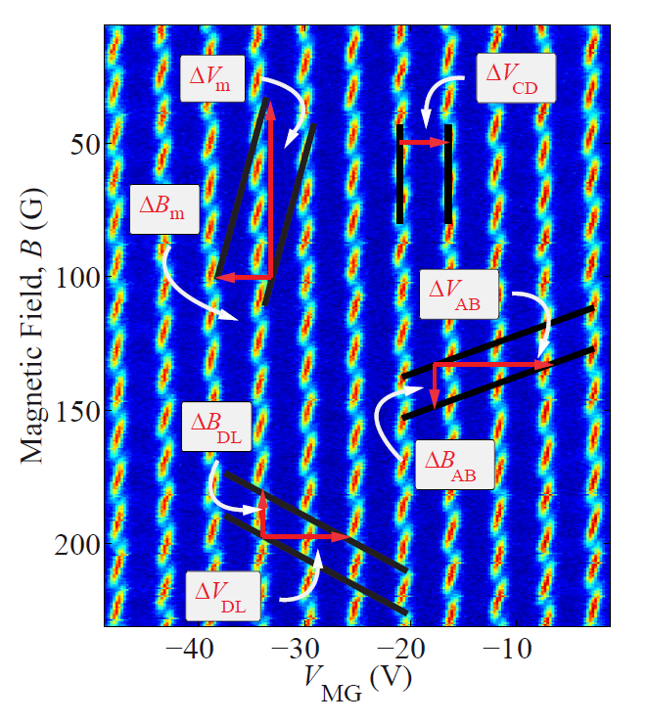
mixture of CD + AB

Slide 24
interference of fractional charges
never observed
(only CD oscillation in bare FPI)

Slide 25
let’s do some test book physics
utilizing edge channels
controlled dephasing
‘which path?’ detection with edge channels

Slide 26
interferometer & detector
u
output
entangled state
l
interference term
‘which path’ information

Slide 27
two equivalent ways to understand dephasing :
detector’s view ---------- ‘which path’ information in detector ⟨χ^{l}⏐χ^{u}⟩
interferometer’s view --- detector scrambles phase (back - action )
Stern Aharonov Imry PRA 1990

Slide 28
resistance detector: path information = resistance change
e.g., QPC
phase detector: path information = phase change
e.g., interferometer

Slide 29
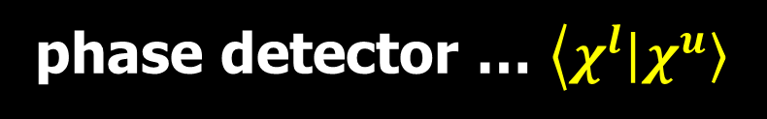
phase detector … $\left\langle χ^{l}\right.\left|\left.χ^{u}\right\rangle \right.$
single electron picture
γ
u
l
ν
T
= 0.5
visibility,
γ
2π
4π
6π
full dephasing

Slide 30
why full dephasing for γ ~ π ?
beam splitter
S_{D}
D1
γ
=π
detector
1.0
intensity (a.u.)
S
0.5
interferometer
D1
0.0
0
1
2
3
4
5
π
)
phase difference (
phase averaging

Slide 31
partitioning
reference path
detector
γ
partitioning
partitioned current line → provides reference path for γ
phase measurement can be performed (in principle)
partitioned current line
→ potential fluctuations → phase scrambling

Slide 32
realization: filling factor = 2 ; calibration
full inner edge channel
interaction length
S_{det}
S_{MZI}
D2
D1
QPC1
QPC2
MG

Slide 33
calibration: unpartitioned detector channel
40
20
Visibility (%)
no dephasing
2π / ~20μV
0
voltage, V_{det} (μV)
1
)
π
π / ~10μV
0
Phase (
-1
-20
-10
0
10
20
voltage, V_{det} (μV)

Slide 34
one electron ~ π
V_{det} ~10 μV → wave packet ~ h υ/e V_{det} ~ 10μm
one electron in arm
inner
e
10μm
V_{det} ~10μV
V_{det}
interaction length ~10μm

Slide 35
dephasing: partitioned detector channel
BS
S2
γ
S1
Φ
D1
QPC2
BS
QPC1
MG
D2

Slide 36
dephasing: partitioned detector channel
reference arm
noisy current
S_{det}
S_{MZI}
D1
QPC1
QPC2
MG

Slide 37
increasing V_{det} … increasing noise & γ
V_{det} = 0 ν~33%
V_{det} = 6μV ν~25%
T_{MZ}
T_{MZ}
V_{MG} (V)
V_{MG} (V)
V_{det} =10μV ν~10%
V_{det} =12μV ν~0%
T_{MZ}
T_{MZ}
complete
dephasing
V_{MG} (V)
V_{MG} (V)
V_{det} =20μV
0.8
T_{MZ}
0.6
interference reappears !
0.4
0.2
0.034
0.036
0.038
0.04
V_{MG} (V)

Slide 38
dephasing is →→ non monotonic !
40
(%)
total dephasing
T_{det}
ν
20
noise increases → visibility increases
visibility,
0
-40
-20
0
20
40
detector voltage, V_{S2} (μV)
single electron prediction
(%)
40
ν
20
visibility,
0
-40
-20
0
20
40
detector voltage, V_{S2} (μV)

Slide 39
γ available ‘in principle’
however, cannot be actually measured
∴ γ (WP information) erased
allowing recovering lost interference

Slide 40
how ?
event #1: 0e in detector …..……. ϕ_{MZI} = ϕ_{AB} + 0
event #2: 1e in detector …….…… ϕ_{MZI} = ϕ_{AB} - π
∴ post select: 1e _{detector} + 1e _{MZI} → deterministic ϕ_{AB} -π
i_{det}
i_{det}·i_{MZI}
i_{MZI}
coincidence = cross correlation

Slide 41
40
(%)
ν
T_{det}
20
visibility,
0
-40
-20
0
20
40
detector Voltage (μV)
f =0.9 period/mV
V_{S2} =0
0.6
V_{S2} ~12μV
0.5
0.4
-111
-109
-107
-105
Modulation Gate Voltage (mV)

Slide 42
cross - correlation dephased MZI ⊗ detector
detector current
dephased interferometer current
i_{det}
i_{det} x i_{MZI}
i_{MZI}
0.034
0.036
0.038
0.04
modulation gate voltage (V)
MZI detector
V_{MZI}= 4μV (~k_{B}T) V_{det} =12μV (strong shot noise)
<1e in path ~1e in path
shot noise 0.8MHz ; bandwidth 30kHz (integrating ~30,000 electrons)

Slide 43
i_{det} x i_{MZI}
(A²/Hz)
x 10
-29
cross-correlation signal
f =0.9 period/mV
2
0
-2
-111
-109
-107
-105
modulation gate voltage (mV)
lost interference recovered

Slide 44
‘high’ detector current → large shot noise
needed to dephase…
is it always necessary ?
example, QD detector in thermal equilibrium no current

Slide 45
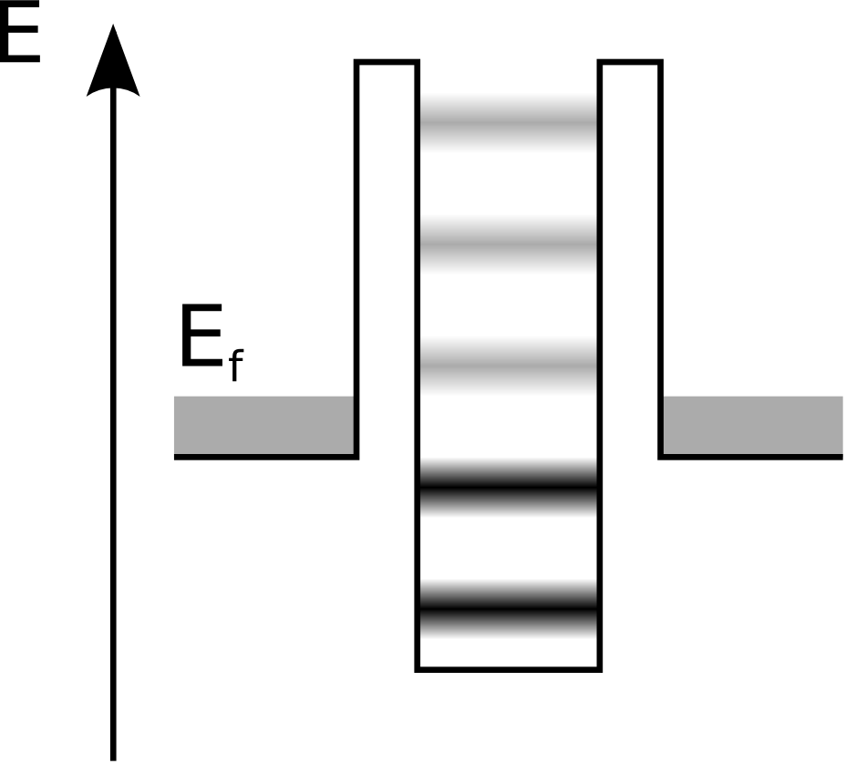
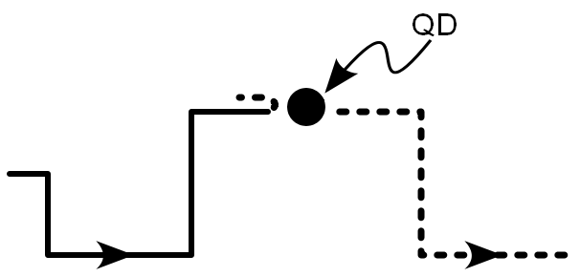
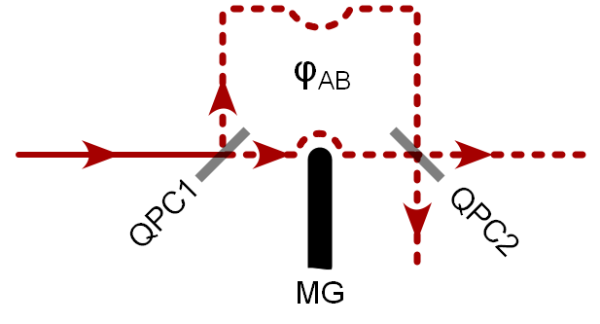
utilizing edge channels …
ν =2
LL2 …….
LL2
Coulomb blockaded QD
LL1

Slide 46
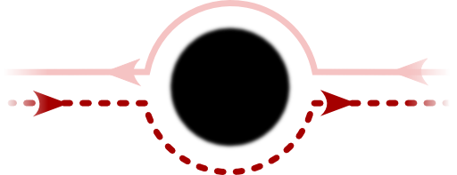
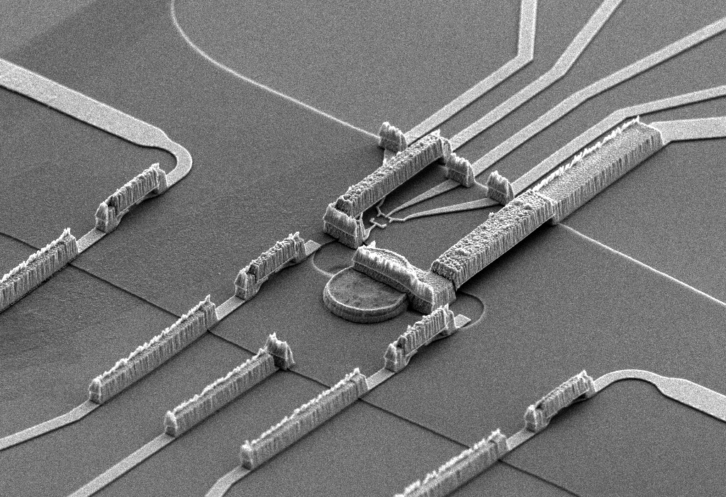
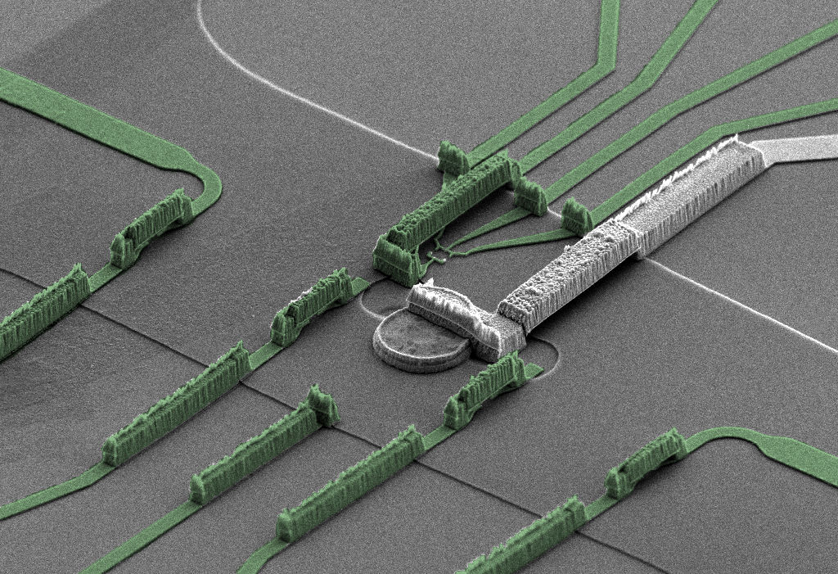
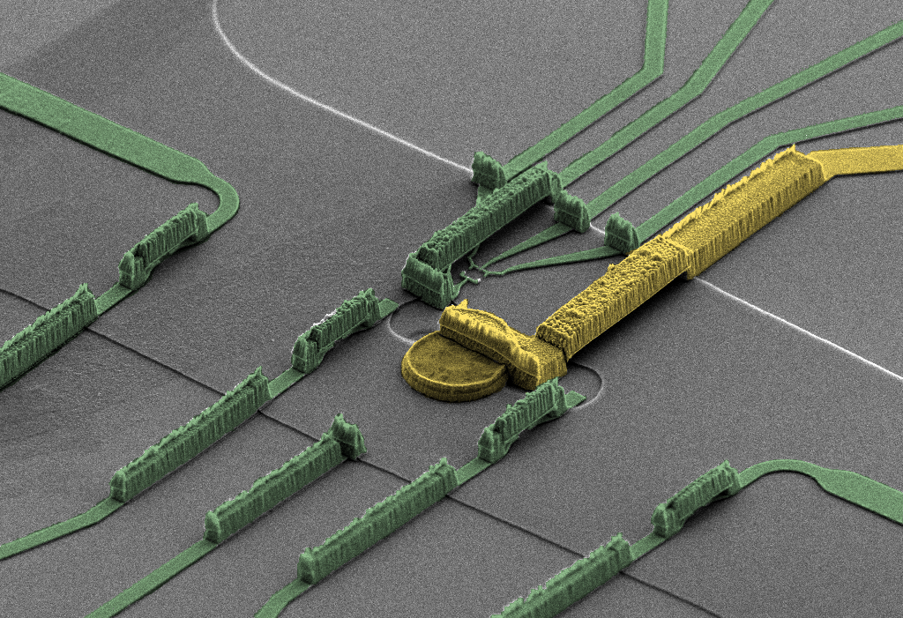
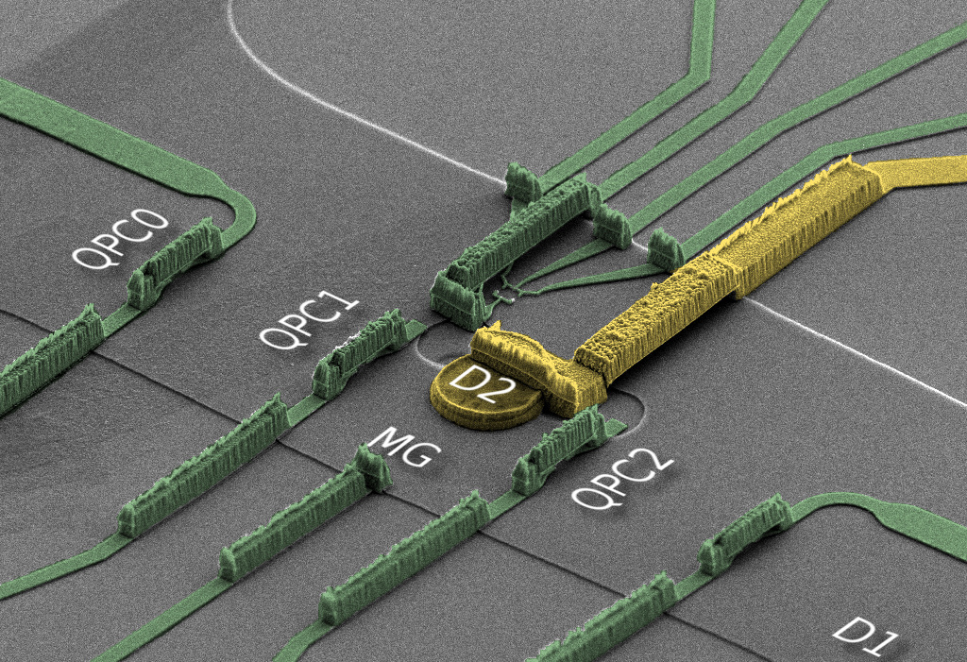
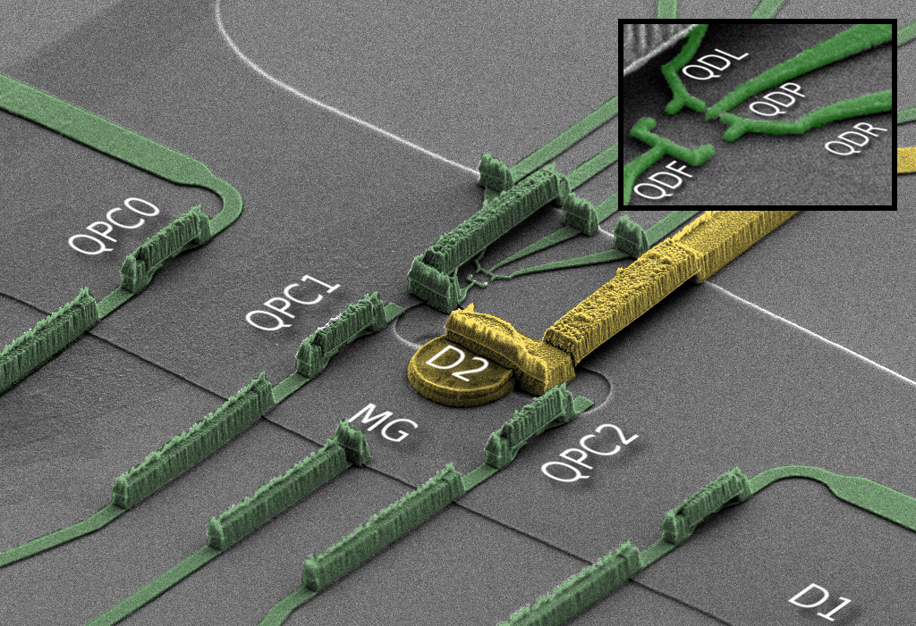
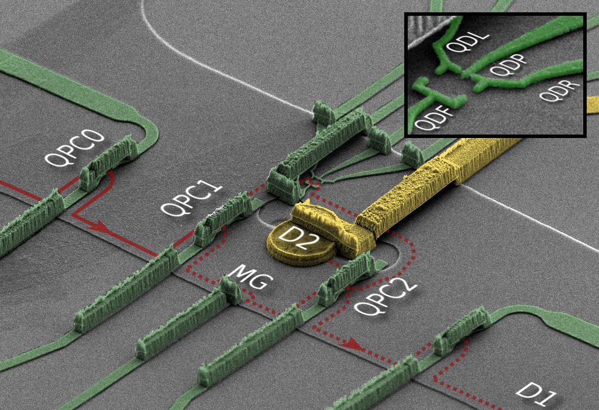
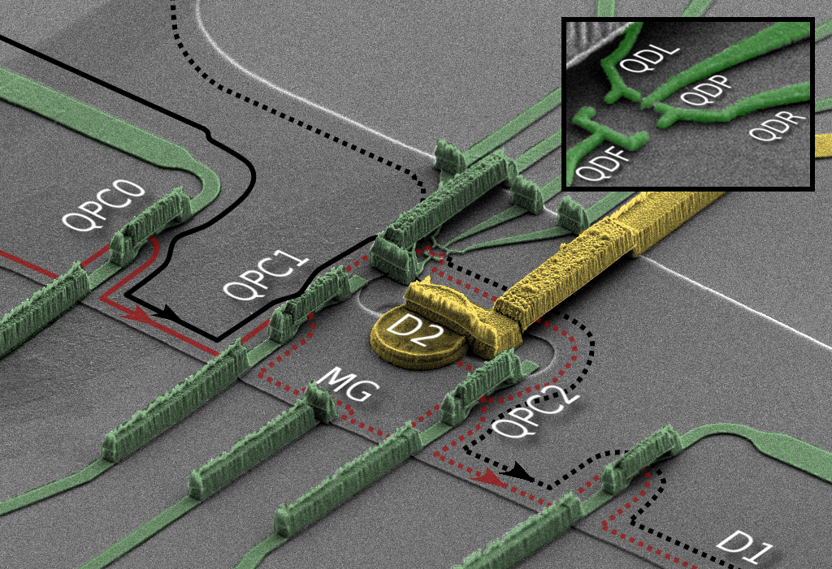


implementation
LL1
LL2
LL1
t =1; MZI upper path
45mK
5.6T→ ν=2

Slide 47
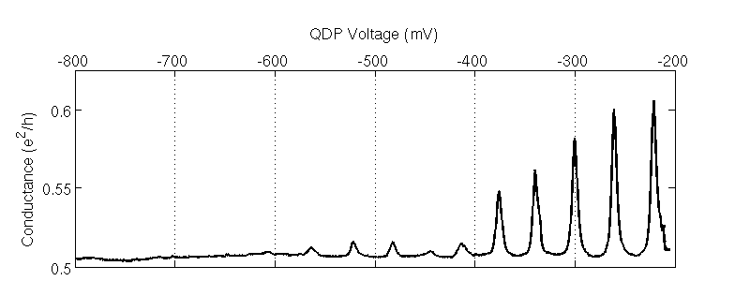
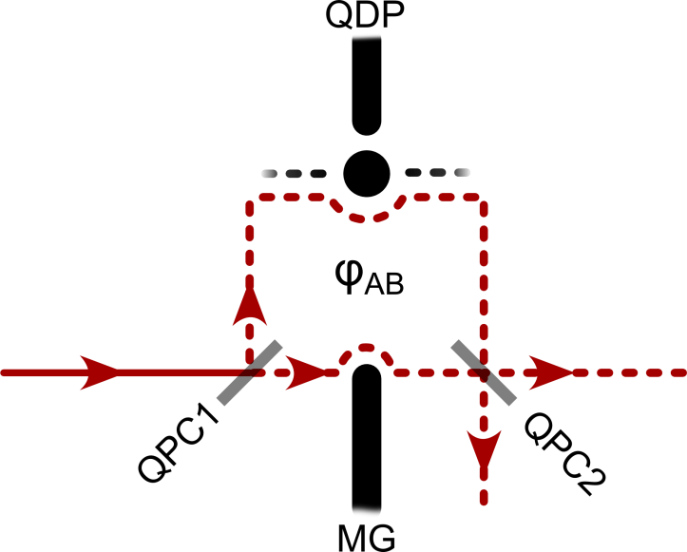
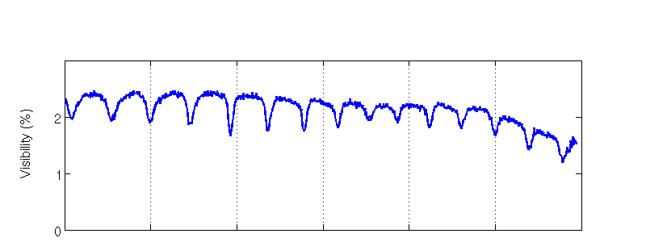
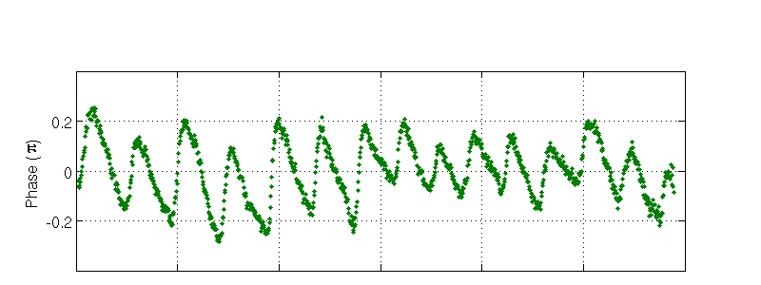
conductive QD
conductance peaks
conductance peaks
pinching LL2
lower arm current →→
LL2
visibility MZI
LL1
phase MZI
~0.4π
~0.2π

Slide 48
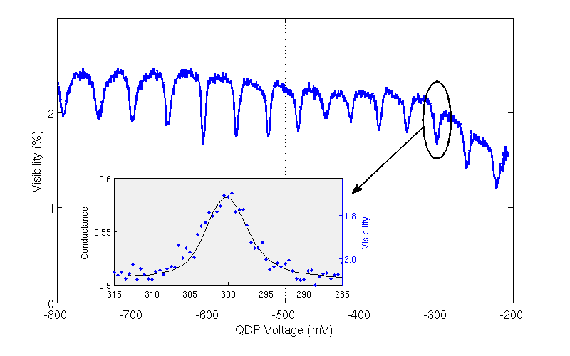
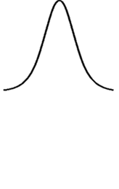
visibility ~ conductance resonance
N+1/2
MZI → occupation detector
N
N+1

Slide 49
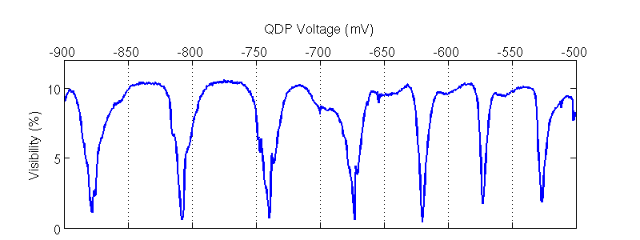




pinching QD & μ(LL2)=0
vanishing conductance peaks
‘zero’ visibility dips
universal’ π phase laps
without current in QD !
~π
π

Slide 50
π slips are rigid
rigidity of π slip @ nearly independent of parameters
N+1/2 on average
N
N+1
ϕ=π
ϕ=0

Slide 51
why π rigidity (pinched dot) ?
Coulomb
‘cold’ channel
LL1
ϕ
LL2
~π
ϕ
LL1
‘hot channel
MZI upper path
(symmetric) Coulomb interaction (no tunneling)
screening only by LL1…….. +e in LL2 QD ……………….. -e in LL1 (hot + cold LL1 channels)
N → N+1………………2ϕ_{scattering} → 2ϕ_{scattering} + 2π ………… ‘Friedel Sum Rule’
total scattering phases change by 2π
Langer & Ambegaokar Phys. Rev. 1961

Slide 52
the MZI ‘dephases itself’ via the QD
may be a model for a dephasing single fluctuating impurity
Rosenow, Gefen, PRL 2012
Chernii et al., PRB 2014

