Slide 1
the world of 2d electrons is exciting:
enabling ‘ballistic high mobility transport’ modulation doping
easy electrostatic control close to surface
unique excitations (quasiparticles)

Slide 2
exchange statistics in the
2d world
richer than the 3d world

Slide 3
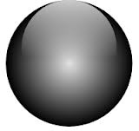
exchange statistics in 3d
bosons
fermions
both

Slide 4
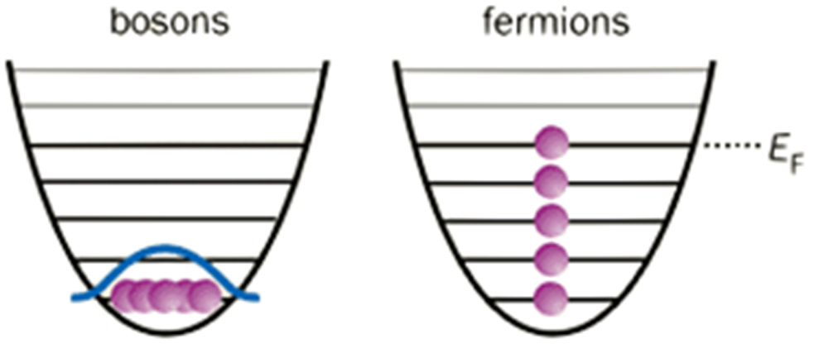
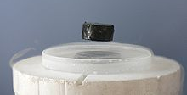
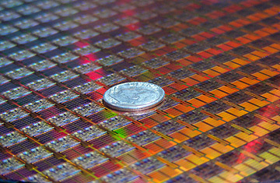
consequences…
bosons
fermions

Slide 5
exchange statistics in 2d → abelian (Laughlin qp’s)
anyons

Slide 6
exchange statistics in 2d → non-abelian
degenerate ground state
exchange → unitary
non-abelian anyons

Slide 7
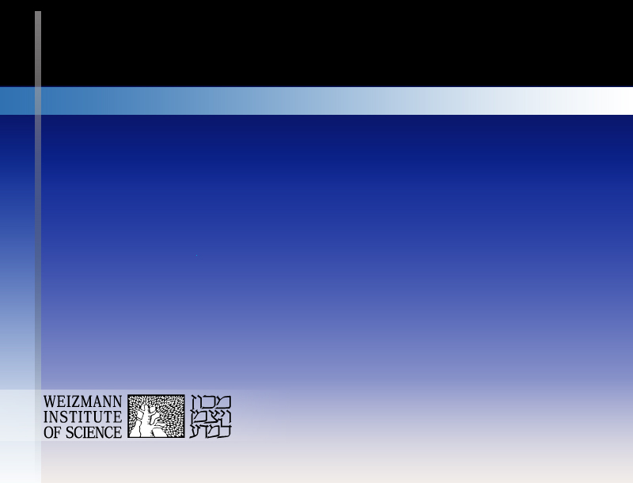
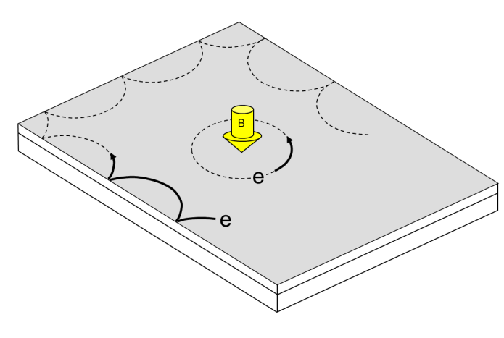
Edge States in QHE Regime …. their nature & use
basics of edge channels in IQHE
doing physics with integer edge channels
studies of edge transport in FQHE regime
deviations from the ‘accepted’ picture
Moty Heiblum

Slide 8
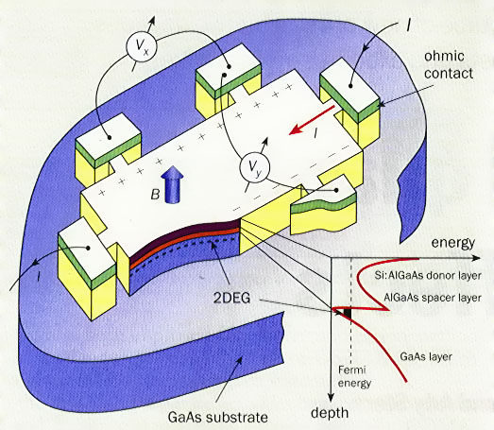
my 2d world
high mobility 2DEG
GaAs-AlGaAs

Slide 9
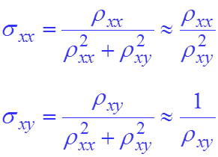
classical Hall effect
L
I
B
electric field
Lorentz
X
W
V_{H} V_{xx}
R_{xy}
R_{xx}
B
σ_{xx} = ρ_{xx} =0

Slide 10
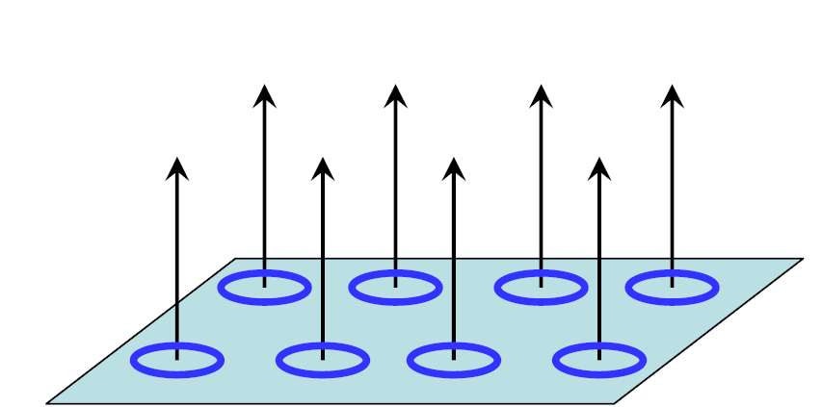
classical electron trajectories
B
most convenient picture…

Slide 11
quantizing the Hall effect

Slide 12
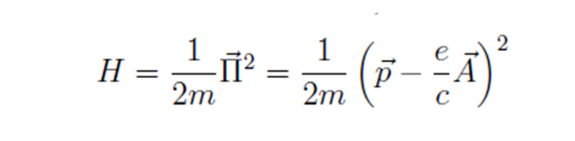
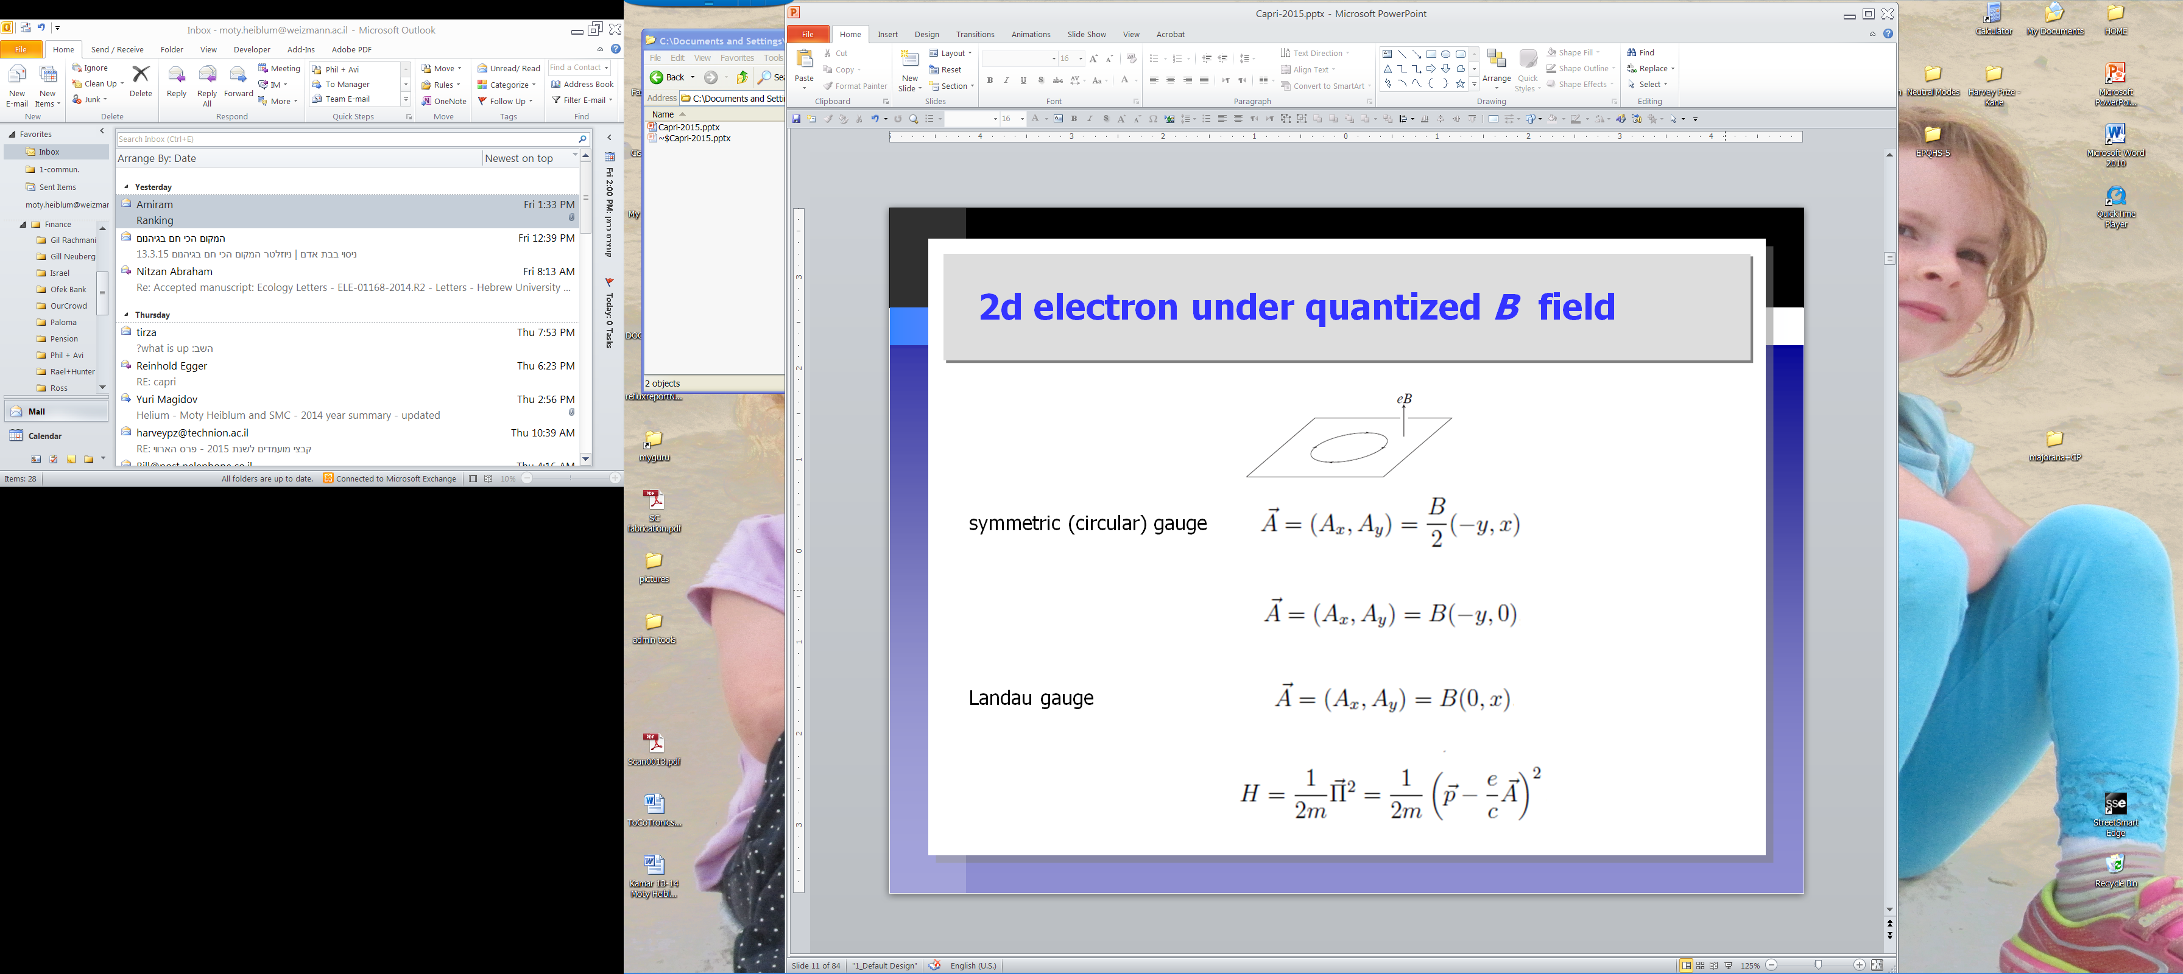
choice of gauges for
H

Slide 13
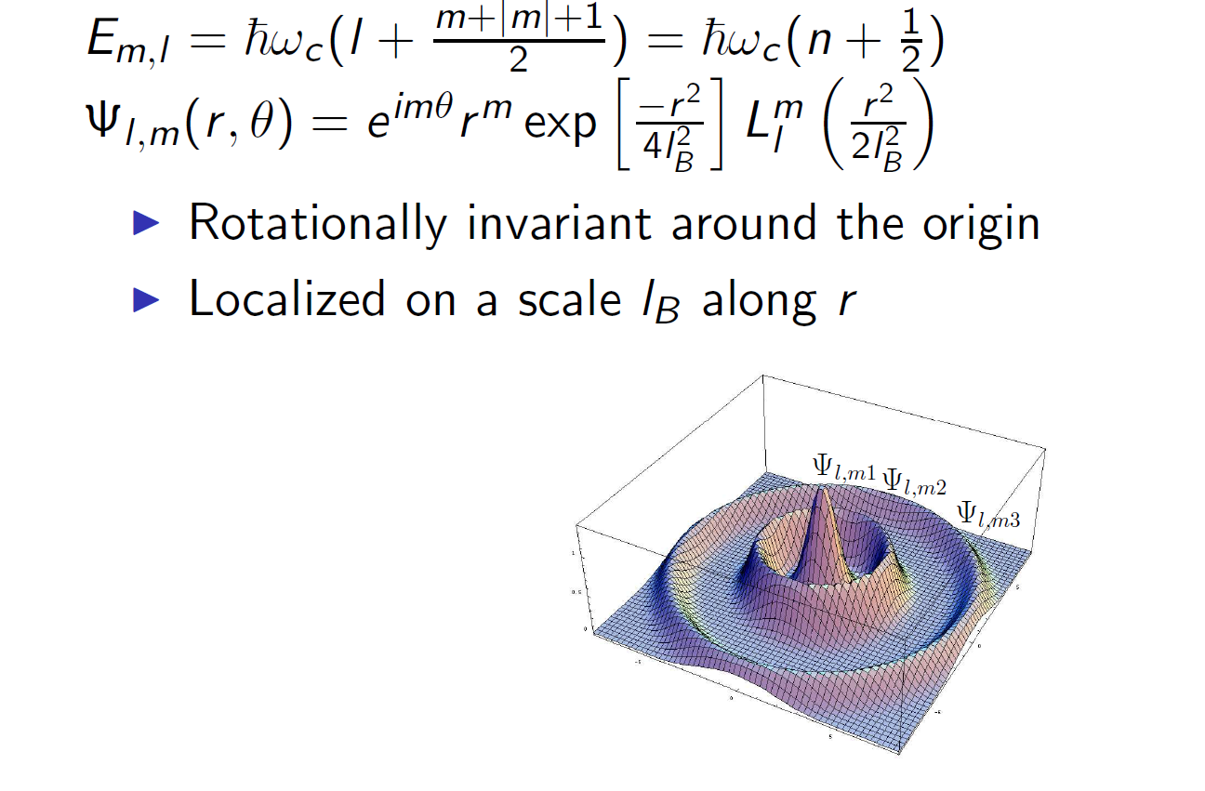
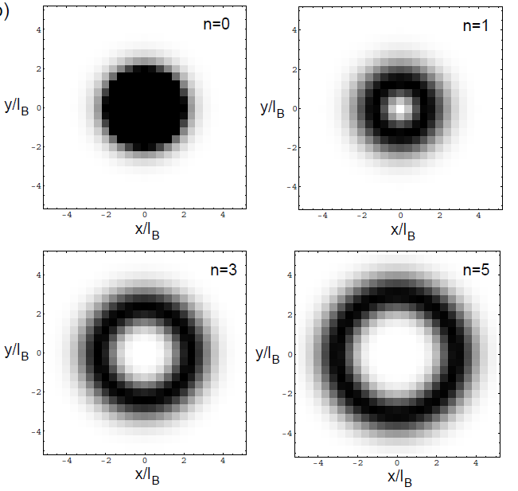
E_{n}
harmonic oscillator
n
n
degeneracy=B /φ₀
m = 1, 2, 3
m=0
φ₀
useful in interference experiments

Slide 14
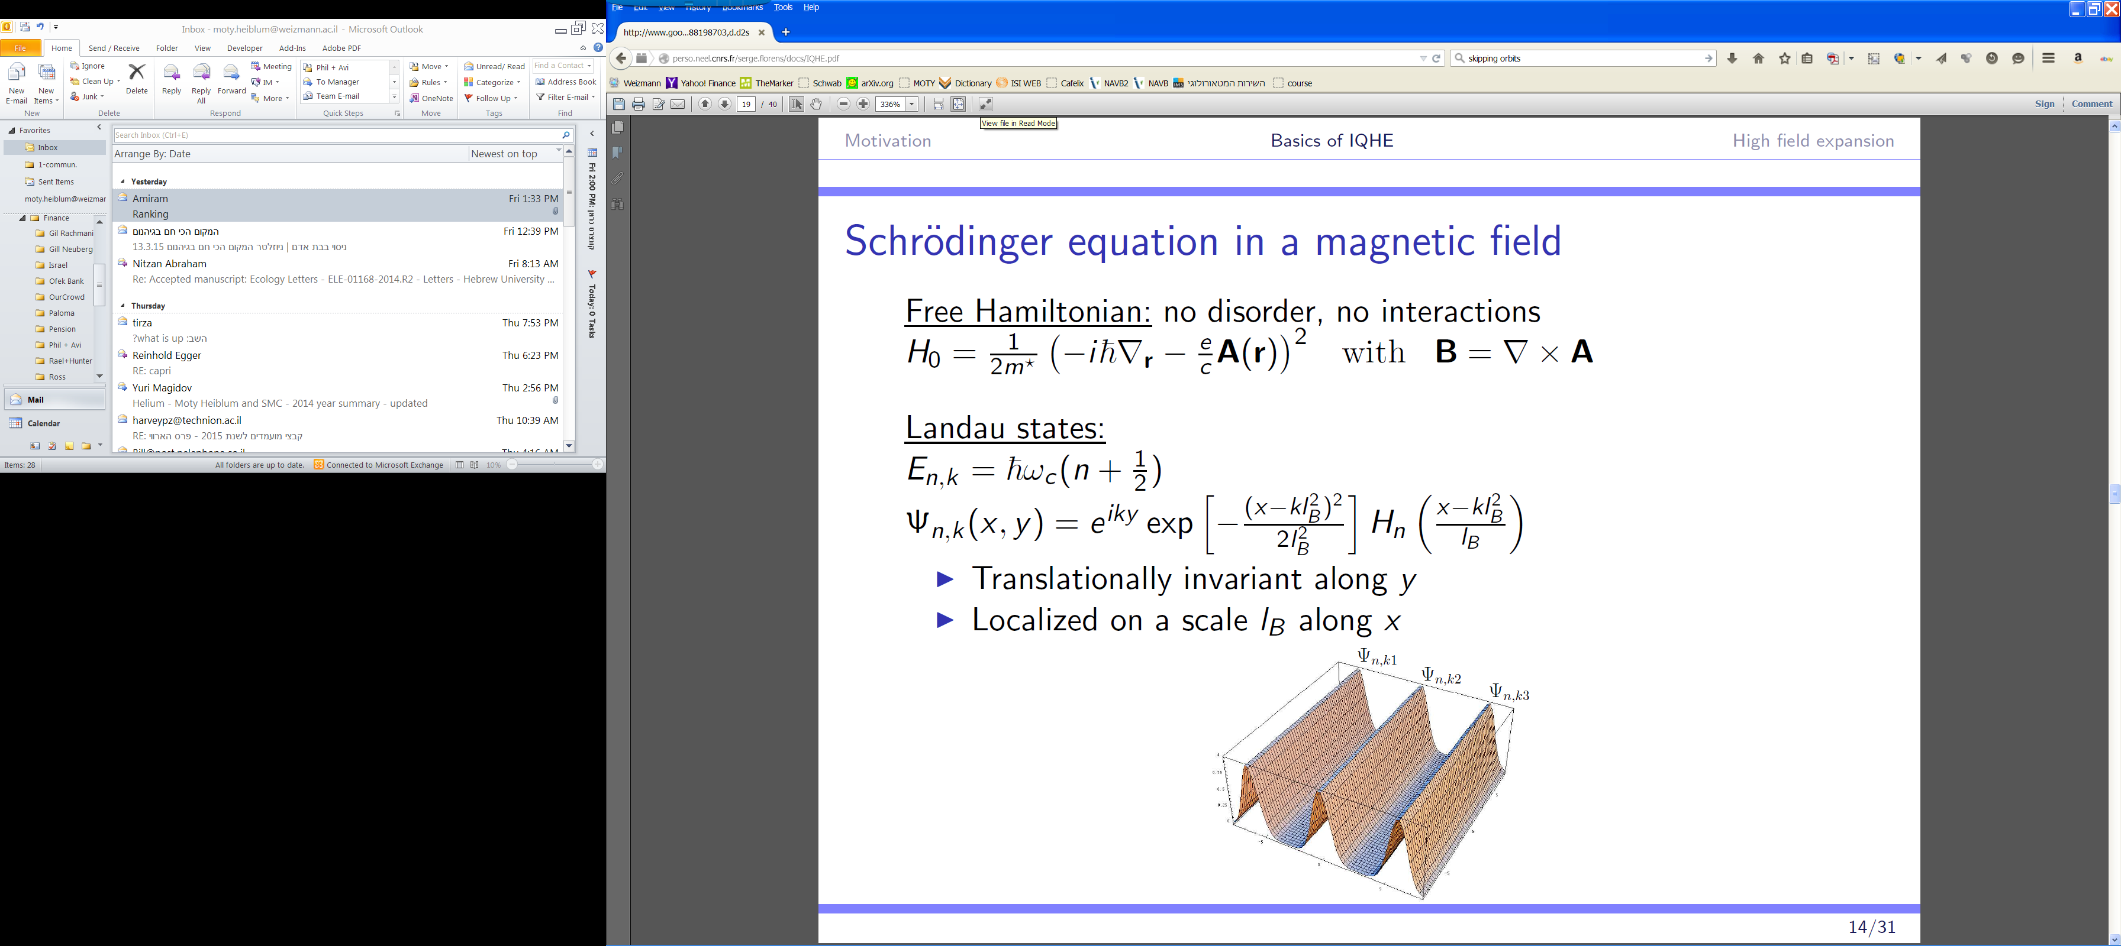
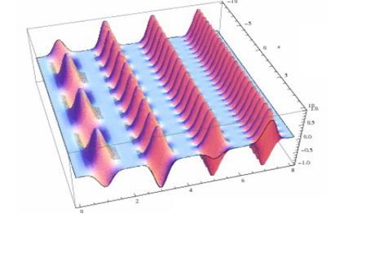
harmonic oscillator
do not carry energy / current
useful in understanding edge modes

Slide 15
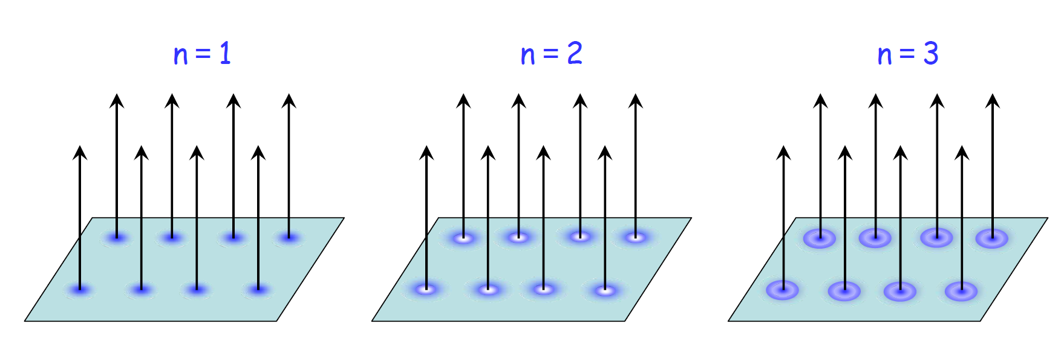
most convenient (another) gauge
resembling classical orbits

Slide 16
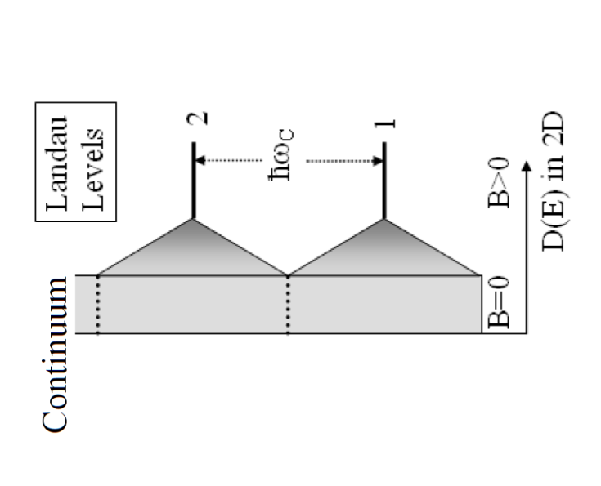
summary
N_{e}
E_{F}
e
N_{e}
E_{F}
ν =2
energy
φ₀=h/e
ν = number of filled LL = number of electrons per flux quantum

Slide 17
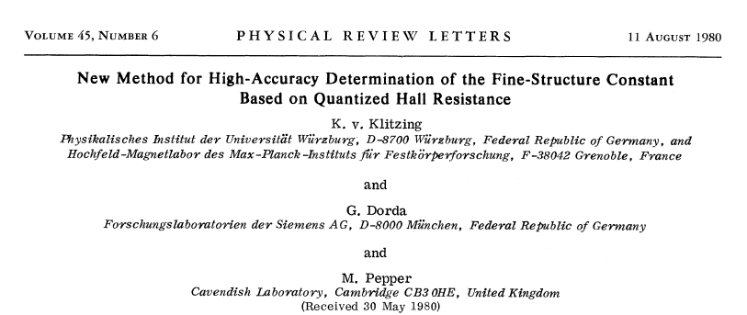
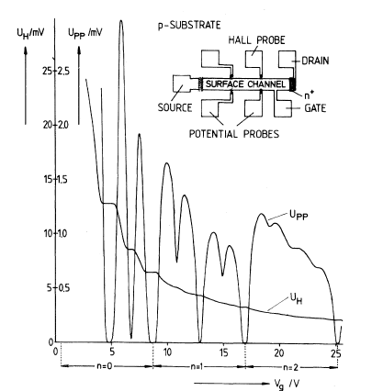
what started it… in a Si MOSFET
B = const.
R_{H} = (ν e ²/h )⁻¹
R_{xx}= 0
n_{s}

Slide 18
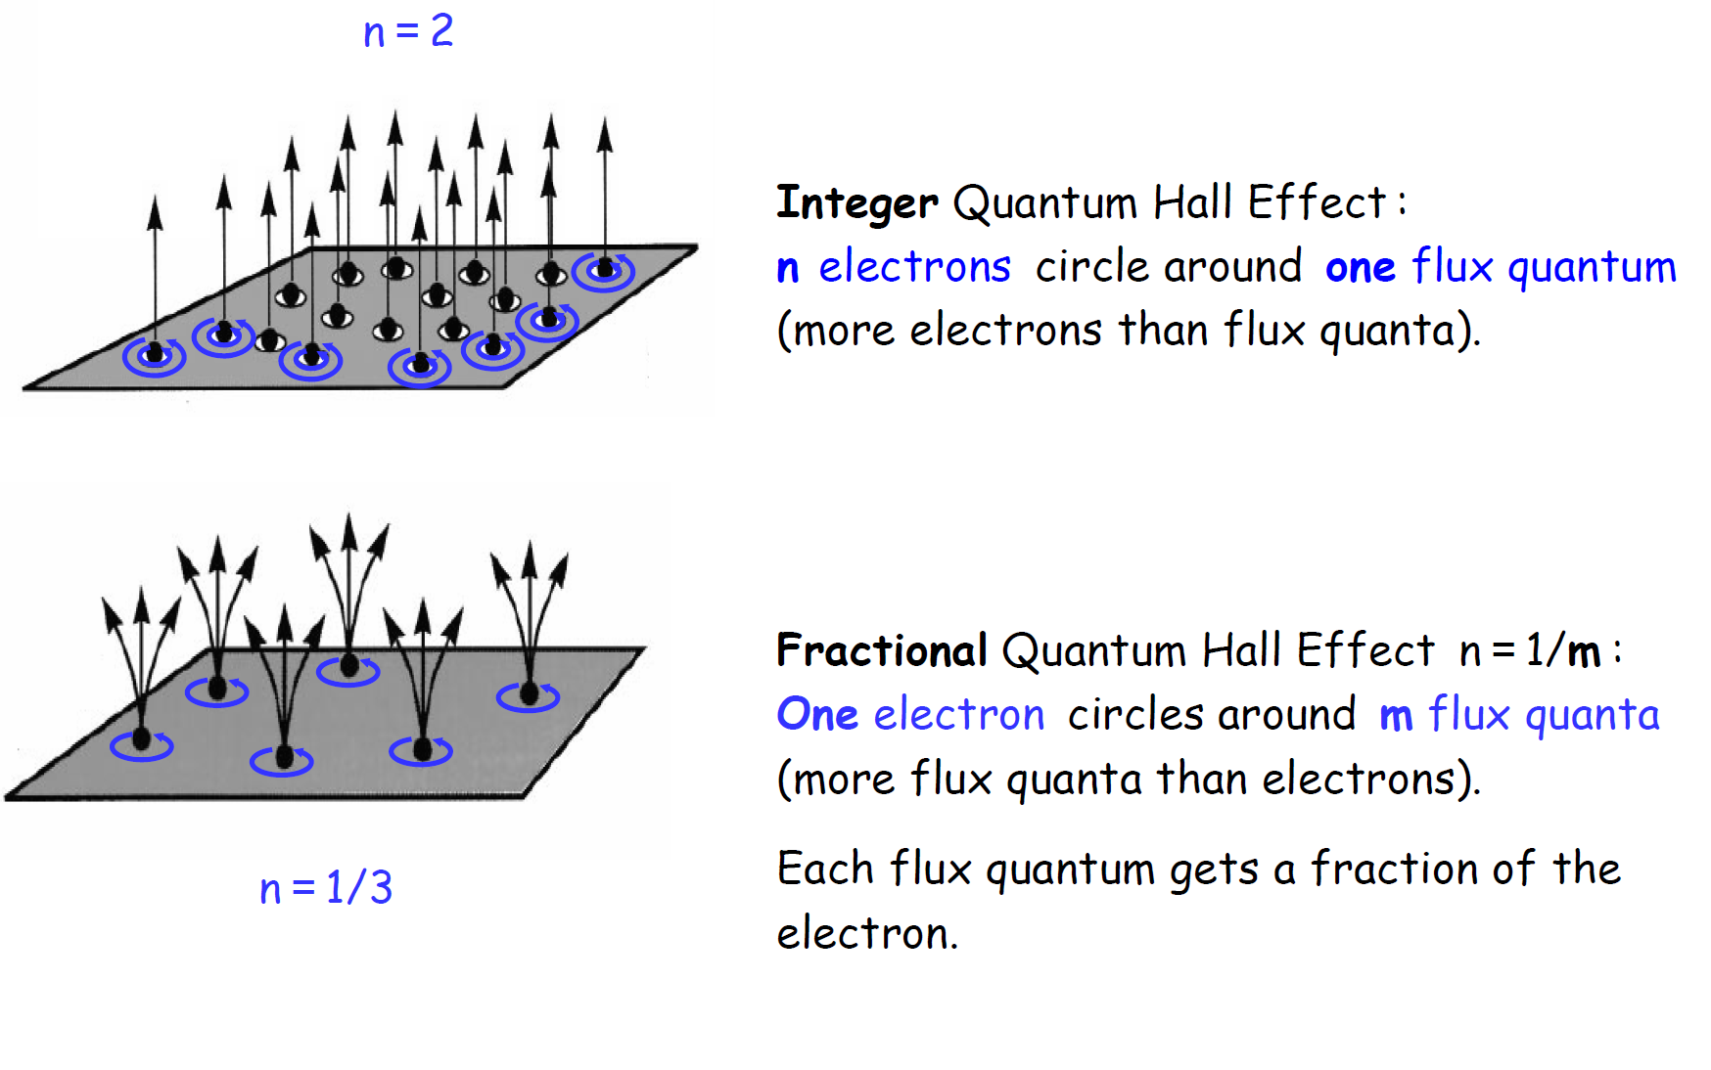
ν = number of electrons per flux quantum

Slide 19
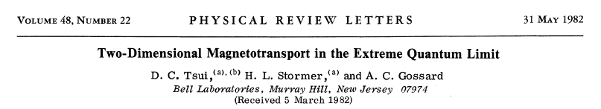
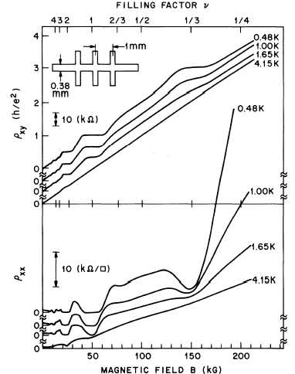
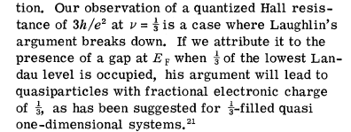
continued with… in a GaAs MODFET
R_{H}=(e ²/3h)⁻¹

Slide 20
ν = number of electrons per flux quantum

Slide 21
σ_{xy}=ν e ²/h
σ_{xx}=0
Magnetic Field, B (Tesla)
plateaus in σ_{xy} and minima in σ_{xx} → energy gap
gauge invariance → E (Φ₀) = E (0)

Slide 22
disordered 2DEG → bulk picture of QHE
plateau
N_{e}
E_{F}
weak disorder
e
localized
does not contribute to current
delocalized
contributes to current

Slide 23
gauge invariance, ν =1/3…
ohmic contact
Φ₀
r
J (r )
=e / 3

Slide 24
state of the art QHE states

Slide 25
few basics of
IQHE edge channels

Slide 26
near the edge skipping orbits
2d layer
B
e
e

Slide 27
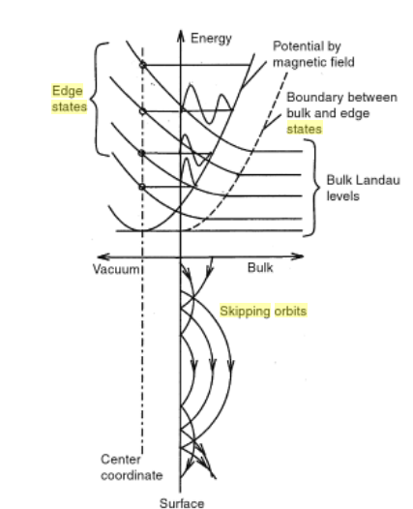
approaching the edge …
truncated harmonic oscillator
approaching the edge → energy curves up
finite drift velocity
v_{d} =ε/B

Slide 28
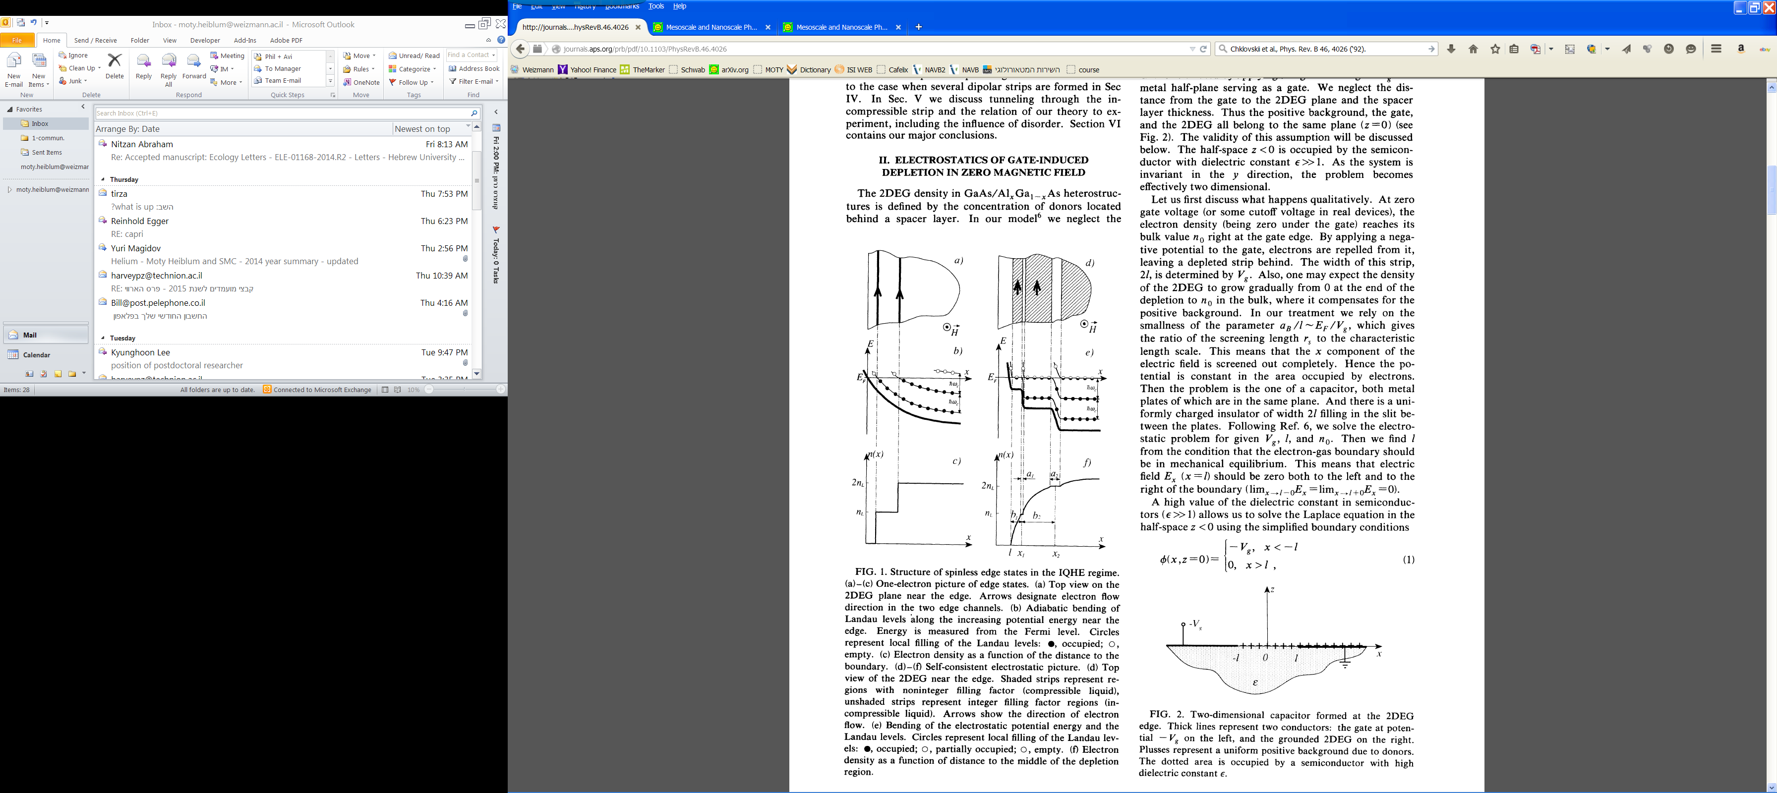
B >>0
simplistic view
B=0

Slide 29
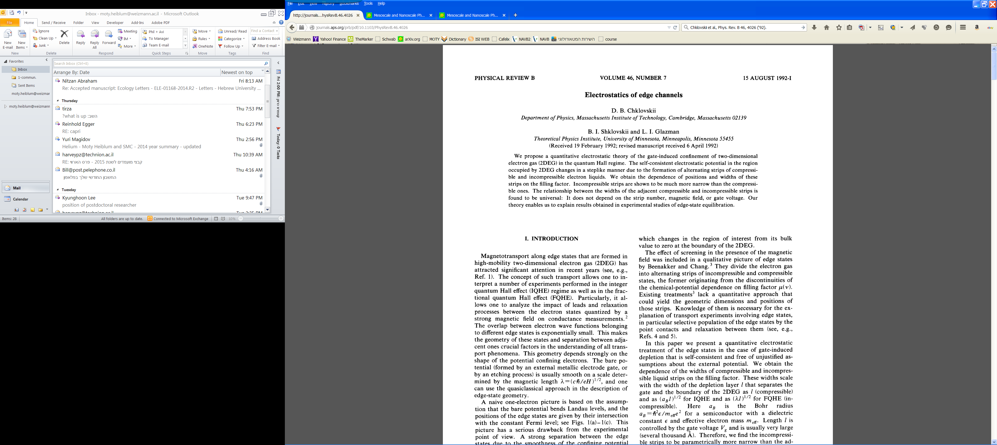
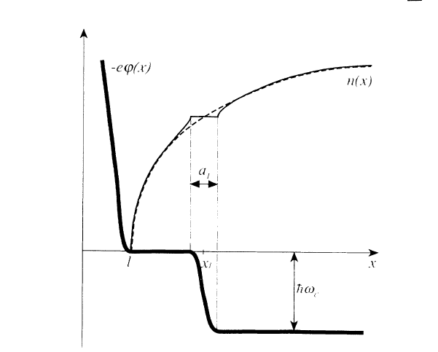
charge imbalance
charging energy
competing with cyclotron energy
compressible
incompressible
density increasing reaching
maximum density of LL
electrons move from LL n+1 to n
gaining cyclotron (Zeeman) energy
E_{F}
LL

Slide 30
proposed edge structure
compressible strips separated by incompressible strips
where does current flow?
    in the insulating strips?
    in the conducting strips?
    arguments continue until today…
    local measurements of current distributions still lacking

Slide 31
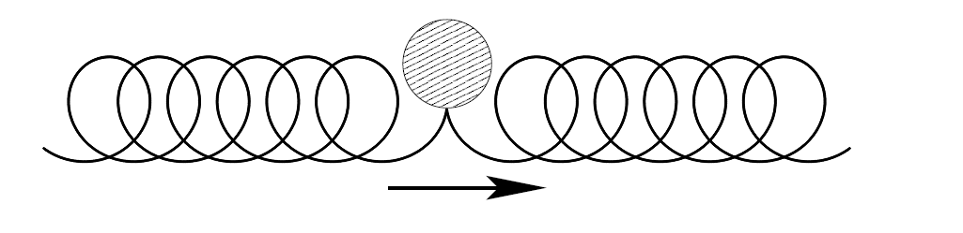
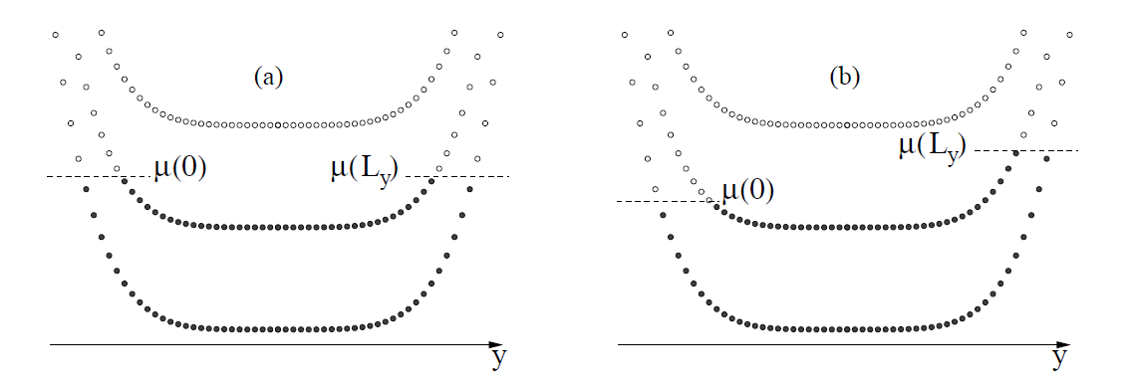
edge channels immune to back scattering
E_{f} +eV
E_{f}
E_{f}
1d edge channel carries

Slide 32
ballistic, but with energy dissipation
hot spot
He4 bubble
He4 bubble

Slide 33
    is the simplistic view of non-interacting
    1d edge channels correct ?
                inter-channel interaction
                intra-channel interaction

Slide 34
inter-channel…
ν =2
g_{Q}= 2 e²/h
e²/h
e²/h
e
LL₁
injecting electrons μ>0
non interacting → Landau levels
μ=0
LL₂
slow ‘neutral’ mode
fast ‘charge’ mode
e/2
e/2
neutral
charge
with interactions → new basis
-e/2
e/2
Berg et al., PRL (2009)

Slide 35
electronic beam splitter
Quantum Point Contact (QPC)
V_{gate}
V_{source}
t
0 < t < 1
QPC
λ_{F}
r

Slide 36
preferential backscattering of edge channels
V_{gate}
transmitted lower LLs
partitioned LL
reflected higher LLs

Slide 37
how to test ? injecting and detecting
inducing noise in LL₁ (hot mode) via QPC
v
e
LL₁
e/2
e/2
neutral
charge
e/2
LL₂
v
-e/2
projecting via QPC to LL₂
(cold mode)
injecting electrons into LL₁
looking for fluctuations in LL₂
with no net current

Slide 38
current fluctuations
shot noise

Slide 39
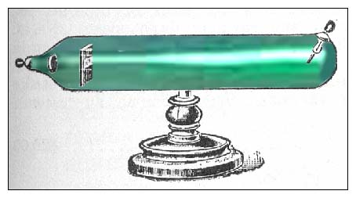
it started with - noise in vacuum tubes
Schottky, 1918
noisy current in vacuum tubes
classical shot noise
cathode
-
+
anode
hot
filament
emitted electrons

Slide 40
classical shot noise
current
time
time
0
large number of impinging electrons
very small escape probability
S_{i} (0)=2 e I
spectral density (A²/Hz)

Slide 41
shot noise =0 …. full Fermi sea (non-partitioned electrons)
V_{applied}
~h/eV_{applied}
zero temperature ordered electrons are noiseless !
Khlus, 1987
Lesovik, 1989

Slide 42
shot noise - single channel
spectral density of current fluctuations
(A²/Hz)
incoming
transmitted
poissonian
S =2eI
Schottky formula
t <<1
binomial
S =2eI (1-t )
t
Khlus, 1987
Lesovik, 1989

Slide 43
conductance and shot noise in QPC
QPC
I
2DEG
V_{g}
3
t₂=1
current responsible
for noise = V g₀ t_{i}
2
conductance (g₀)
1
t₁=1
S ∝ t (1-t )
noise
gate voltage, V_{g}

Slide 44
shot noise in QPC
- experimental results -
/Hz)
2
6
A
-28
T =57 mK
(10
t =0.37
4
I
2
current noise, S
0
0
1
2
3
current, I (nA)

Slide 45
experimental considerations
2DEG : n_{s}=1.1x10¹¹ cm⁻² ; μ=4 x10⁶ cm²/Vs
shot noise signal S_{i}(0)=2e*I=10 ⁻²⁹ A²/Hz ...…………… T*~ 40 mK
Johnson noise……………………………………………. T ~ (10-30) mK
noise in ‘warm electronics’……….....……………………T*~ 3.5 K
“home made” (MODFET) cryogenic preamplifier (T= 4.2 K)
T*~100-200 mK at f₀ = 1 - 4 MHz (above 1/f noise knee)

Slide 46
difficulties in measurements
(cold, 50 mK)
coaxial cable
(hot, 4.2 K)
δV=R δi
60cm 60pF
cooled
preamp
spectrum
analyzer
(δ i)²
QPC
R
QPC resistance R ~ 100 kΩ
coax capacitance C ~ 60 pF
f_{max} = 1/(2π RC) ~ 30 kHz
1/f noise is large

Slide 47
experimental setup
frequency above 1/f noise corner of preamplifier;
capacitance compensated by resonant circuit;
calibration signal
cryostat
50 Ω ; 300 K
averaging time,τ
C<<
voltage gain = 1000
DC current
f₀ ,Δf₀
noise <i²>
cooled
preamp
warm
preamp
V_{DC}
1 GΩ
‘home made’
L
C
R
spectrum
analyzer
QPC
coax

Slide 48
injecting and detecting
inducing noise in LL₁ (hot mode) via QPC
e
LL₁
e/2
e/2
neutral
charge
LL₂
-e/2
e/2
projecting via QPC to LL₂
(‘cold ‘ channel )
open QPC …………………………... no net current
no low frequency noise
partition QPC ………………………no net current low frequency noise
semi-classically:
mutual capacitance between the two edge modes
high frequency (~GHz) noise in hot LL₁ is induced n LL₂
stochastic partitioning by QPC adds low-frequency spectrum

Slide 49
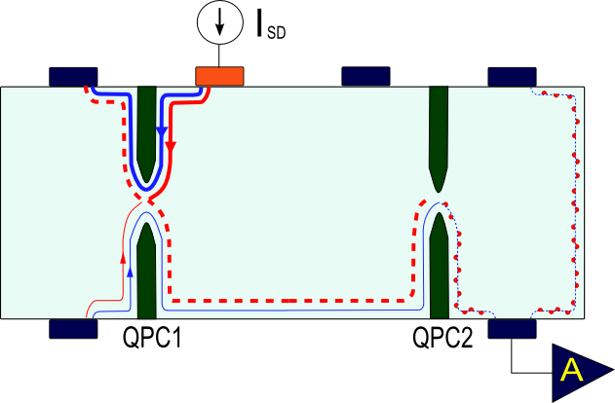

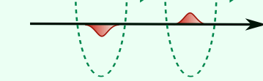
partitioning also the ‘cold channel’
G
G
G
T
G
Inoue et al, PRL (2014)

Slide 50
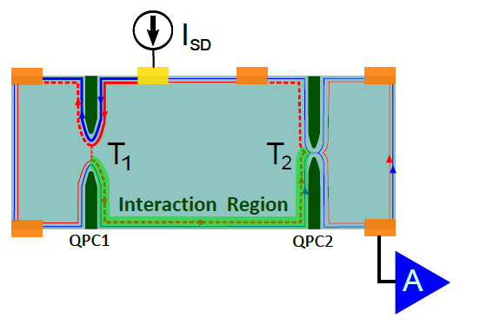
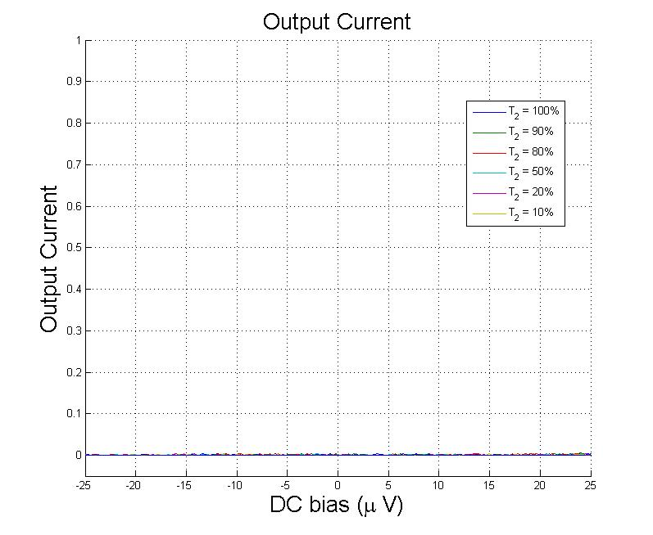
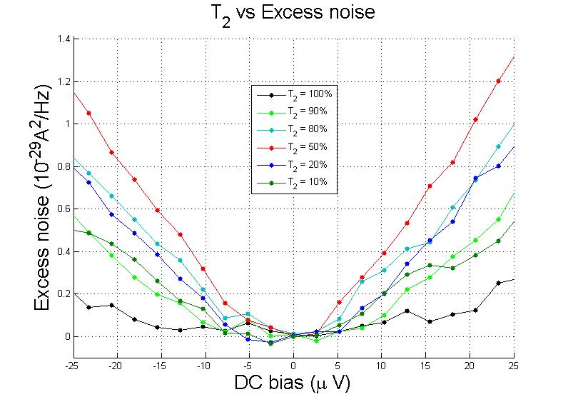
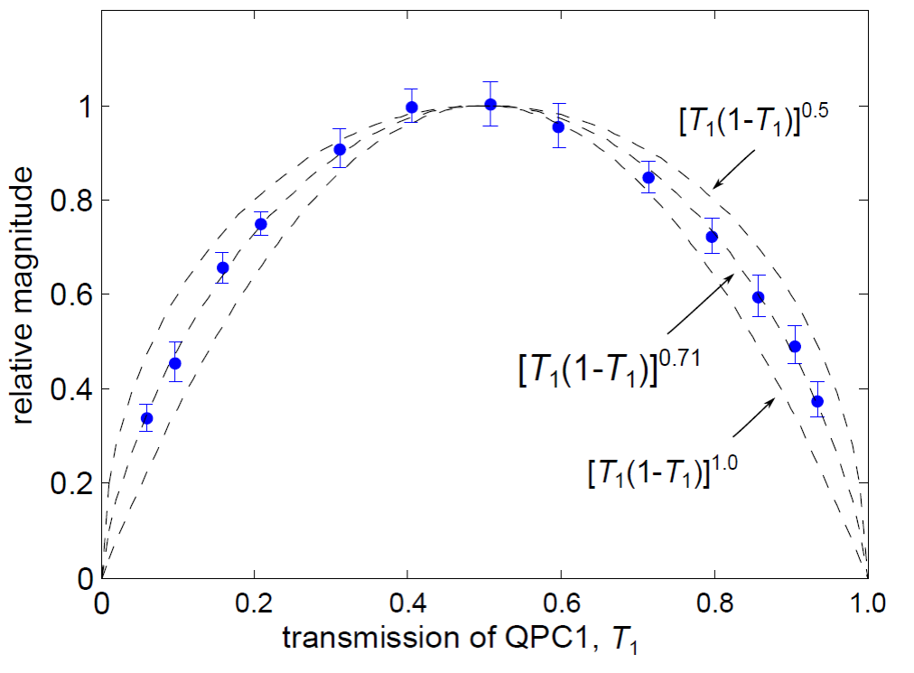
current of ‘cold mode’
T₁=0.5
no net current
T₁ dependence
T₂ dependence
~T₂(1-T₂)

Slide 51
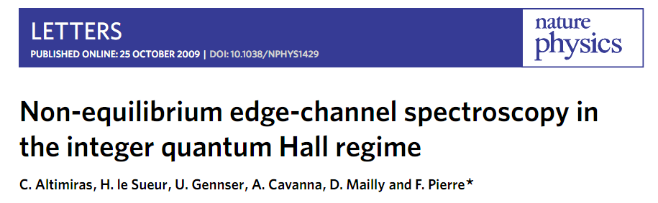
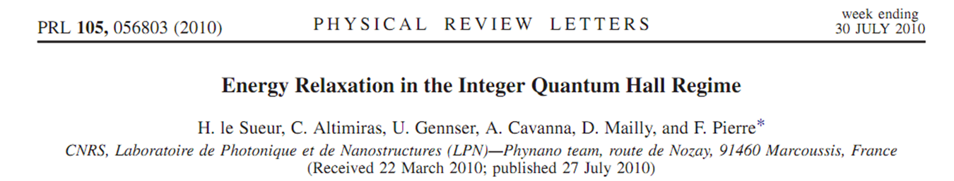
intra-channel…

Slide 52
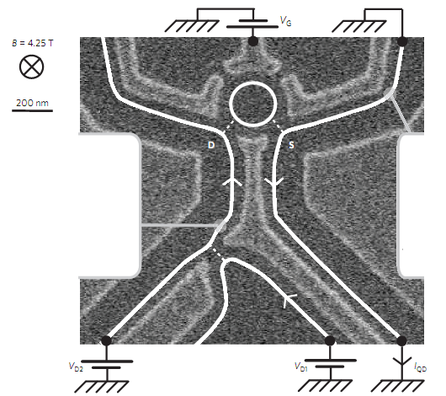
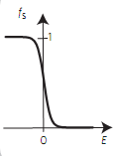
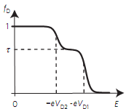
QD – narrow BPF
QD
cold channel
τ
warm channel
hot channel
V_{D2}
V_{D1}

Slide 53
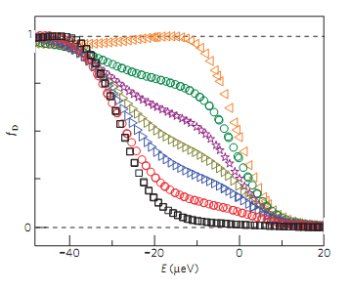
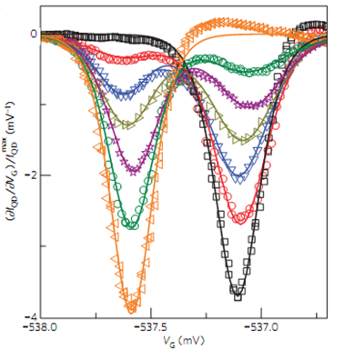
energy distribution (QD)
τ=0
-
τ=1

Slide 54
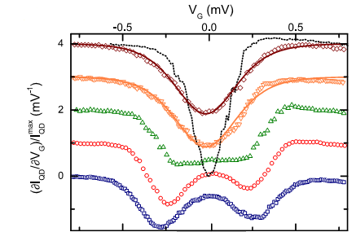

energy equilibration with distance
equilibration due to e - e interactions

Slide 55
simplistic view of integer edge channels fails
interactions are dominant
we make use of it…

